Slide 1
Tree data structures
Introduction

Slide 2
Tree Data Structure
A tree is a nonlinear hierarchical data structure that consists of nodes connected by edges.
Other data structures such as arrays, linked list, stack, and queue are linear data structures that store data sequentially. In order to perform any operation in a linear data structure, the time complexity increases with the increase in the data size. But, it is not acceptable in today's computational world.
Different tree data structures allow quicker and easier access to the data as it is a non-linear data structure.

Slide 3
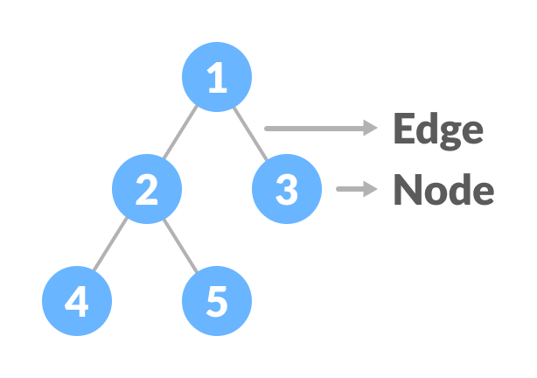
Tree Terminologies
Node
A node is an entity that contains a key or value and pointers to its child nodes.
The last nodes of each path are called leaf nodes or external nodes that do not contain a link/pointer to child nodes.
The node having at least a child node is called an internal node.
Edge
It is the link between any two nodes.
Root
It is the topmost node of a tree.
Degree of a Node
The degree of a node is the total number of branches of that node.
Root

Slide 4
Types of Tree
BINARY TREE
BINARY SEARCH TREE
B-TREE
B+ TREE
RED-BLACK TREE

Slide 5
Tree Applications
Binary Search Trees(BSTs) are used to quickly check whether an element is present in a set or not.
Heap is a kind of tree that is used for heap sort.
A modified version of a tree called Tries is used in modern routers to store routing information.
Most popular databases use B-Trees and T-Trees, which are variants of the tree structure we learned above to store their data
Compilers use a syntax tree to validate the syntax of every program you write.

Slide 6
Tree Traversal - inorder, preorder and postorder
Traversing a tree means visiting every node in the tree. You might, for instance, want to add all the values in the tree or find the largest one. For all these operations, you will need to visit each node of the tree.
Linear data structures like arrays, stacks, queues, and linked list have only one way to read the data. But a hierarchical data structure like a tree can be traversed in different ways.
Every tree is a combination of
A node carrying data
Two subtrees
Remember that our goal is to visit each node, so we need tovisit all the nodes in the subtree, visit the root node and visit all the nodes in the right subtree as well.Depending on the order in which we do this,there can be three types of traversal.

Slide 7
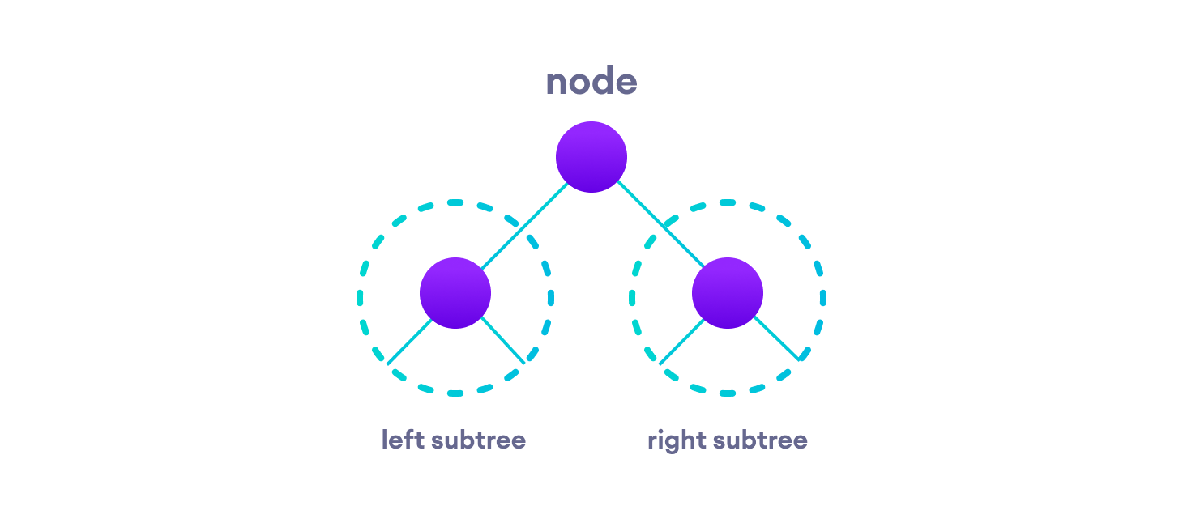
Inorder traversal
First, visit all the nodes in the left subtree
Then the root node
Visit all the nodes in the right subtree
Preorder traversal
Visit root node
Visit all the nodes in the left subtree
Visit all the nodes in the right subtree
Postorder traversal
Visit all the nodes in the left subtree
Visit all the nodes in the right subtree
Visit the root node

Slide 8
Binary Tree
A binary tree is a tree data structure in which each parent node can have at most two children. Each node of a binary tree consists of three items:
data item
address of left child
address of right child

Slide 9
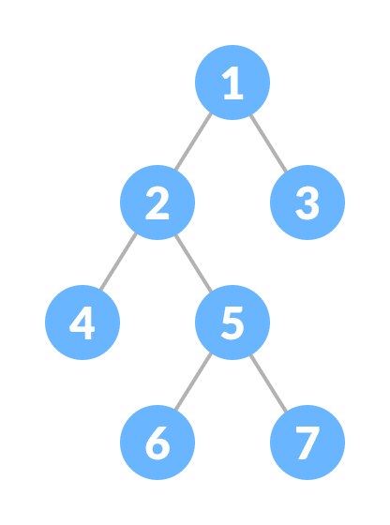
Types of Binary Tree
1. Full Binary Tree
A full Binary tree is a special type of binary tree in which every parent node/internal node has either two or no children.

Slide 10
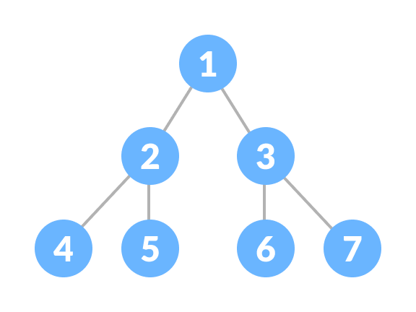
2. Perfect Binary Tree
A perfect binary tree is a type of binary tree in which every internal node has exactly two child nodes and all the leaf nodes are at the same level.

Slide 11
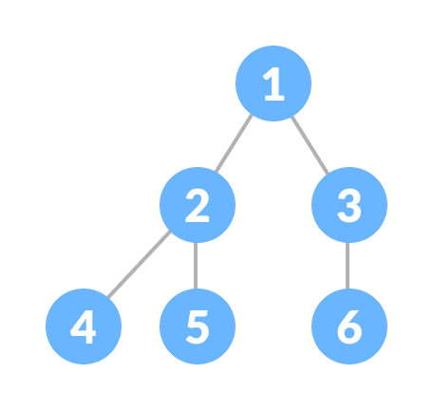
3. Complete Binary Tree
A complete binary tree is just like a full binary tree, but with two major differences
Every level must be completely filled
All the leaf elements must lean towards the left.
The last leaf element might not have a right sibling i.e. a complete binary tree doesn't have to be a full binary tree.

Slide 12
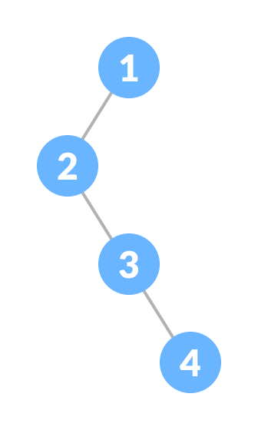
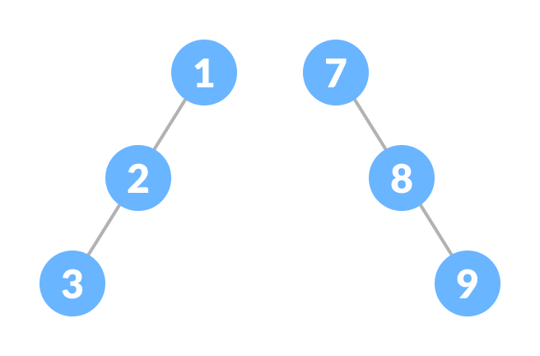
4. Degenerate or Pathological Tree
A degenerate or pathological tree is the tree having
a single child either left or right.
5. Skewed Binary Tree
A skewed binary tree is a pathological/degenerate tree in which the tree is either dominated by the left nodes or the right nodes. Thus, there are two types of skewed binary tree:
left-skewed binary tree and right-skewed binary tree.

Slide 13
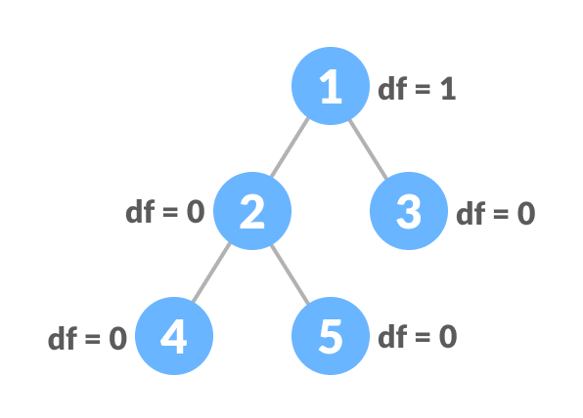
6. Balanced Binary Tree
It is a type of binary tree in which the difference between the height of the left and the right subtree for each node is either 0 or 1.

Slide 14
Binary Tree Applications
For easy and quick access to data
In router algorithms
To implement heap data structure.
Syntax tree

Slide 15
Binary Search Tree(BST)
Binary search tree is a data structure that quickly allows us to maintain a sorted list of numbers.
It is called a binary tree because each tree node has a maximum of two children.
It is called a search tree because it can be used to search for the presence of a number in
O(log n) time.
The properties that separate a binary search tree from a regular binary tree is
All nodes of left subtree are less than the root node
All nodes of right subtree are more than the root node
Both subtrees of each node are also BSTs i.e. they have the above two properties

Slide 16
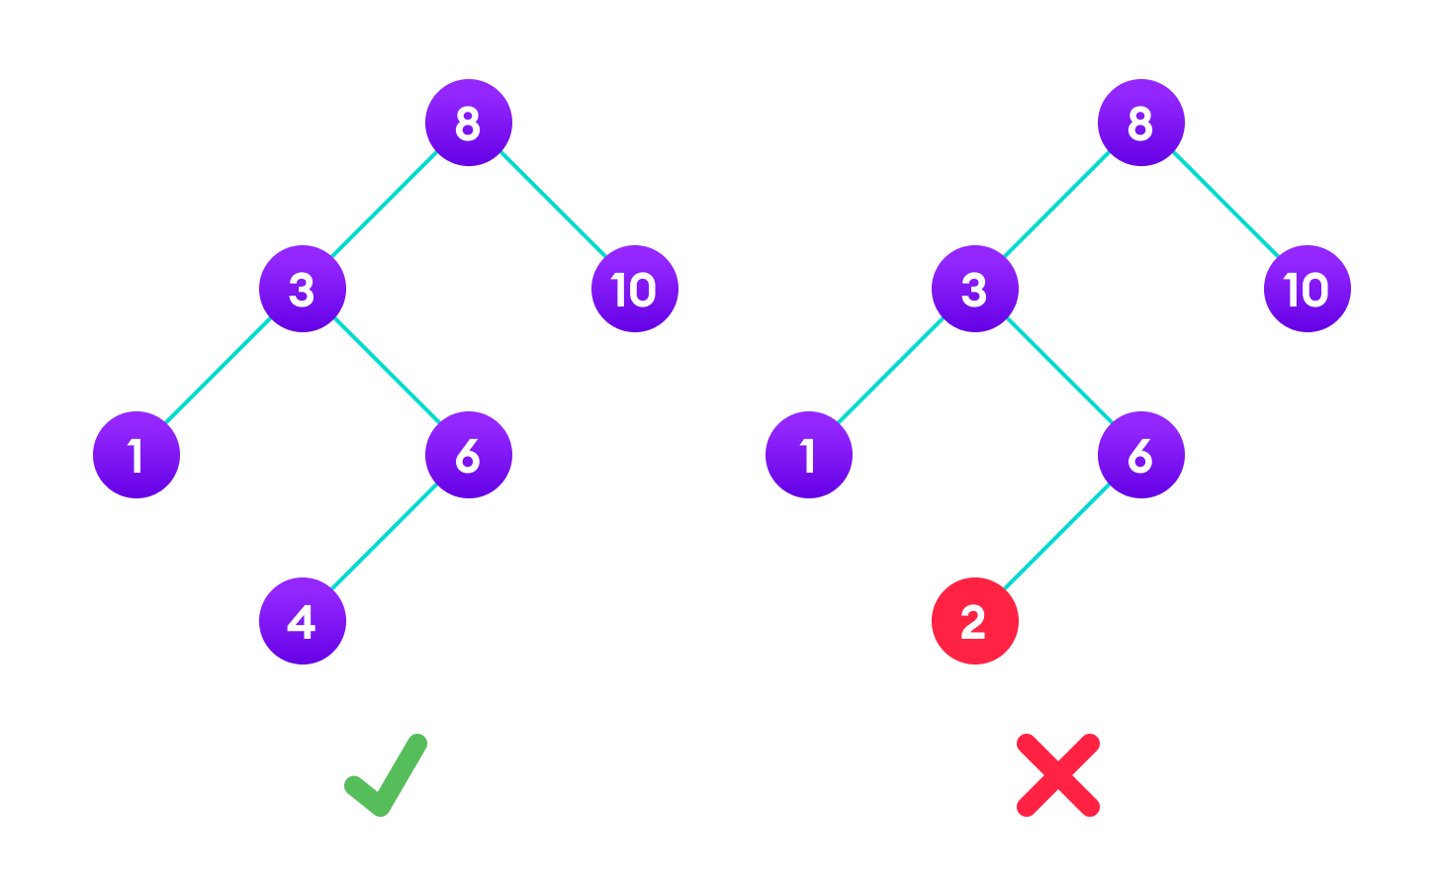
The binary tree on the right isn't a binary search tree because the right subtree of the node "3" contains a value smaller than it.

Slide 17
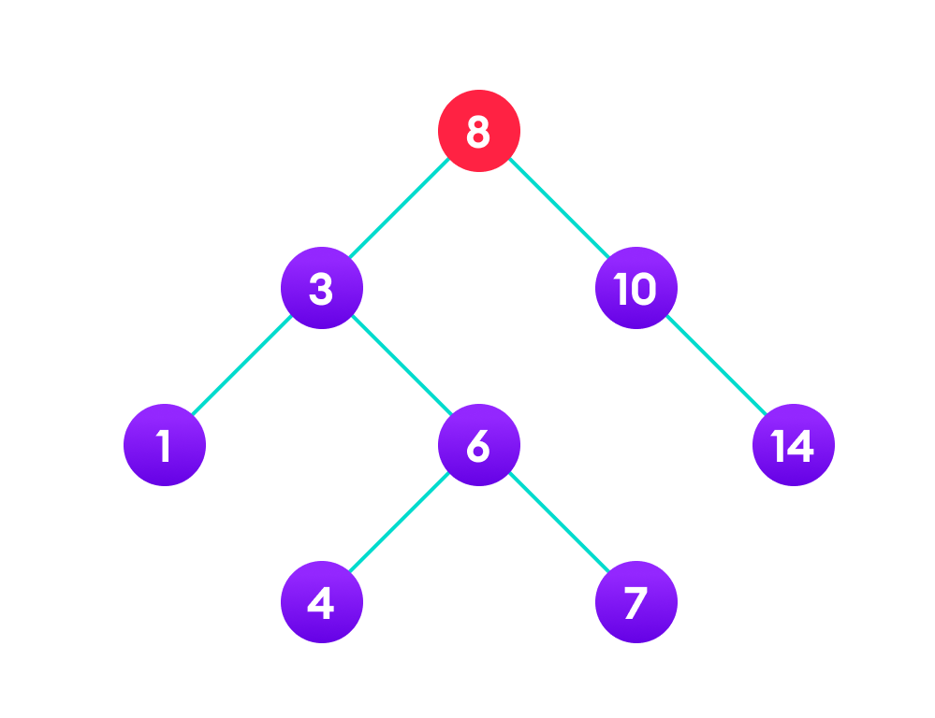
Search Operation The algorithm depends on the property of BST that if each left subtree has values below root and each right subtree has values above the root. If the value is below the root, we can say for sure that the value is not in the right subtree; we need to only search in the left subtree and if the value is above the root, we can say for sure that the value is not in the left subtree; we need to only search in the right subtree.

Slide 18
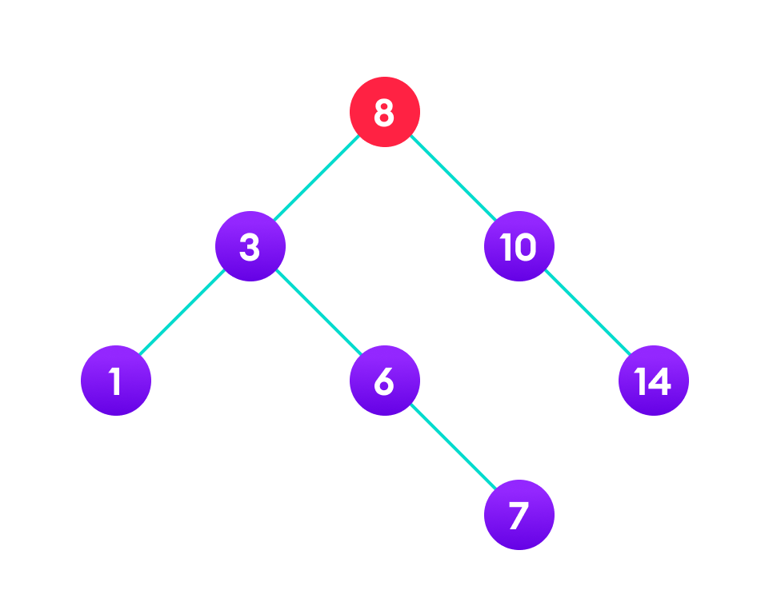
Insert Operation Inserting a value in the correct position is similar to searching because we try to maintain the rule that the left subtree is lesser than root and the right subtree is larger than root. We keep going to either right subtree or left subtree depending on the value and when we reach a point left or right subtree is null, we put the new node there.

Slide 19
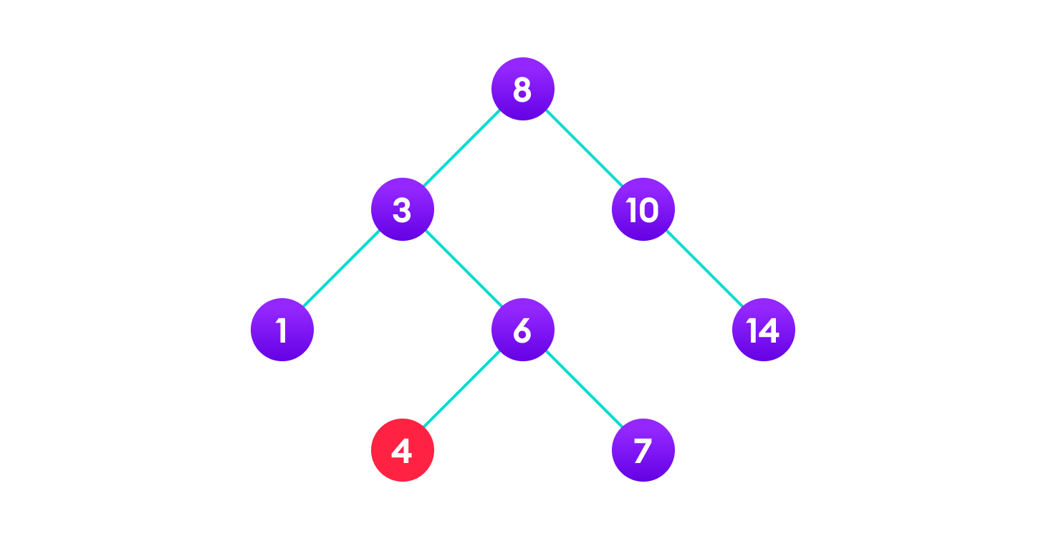
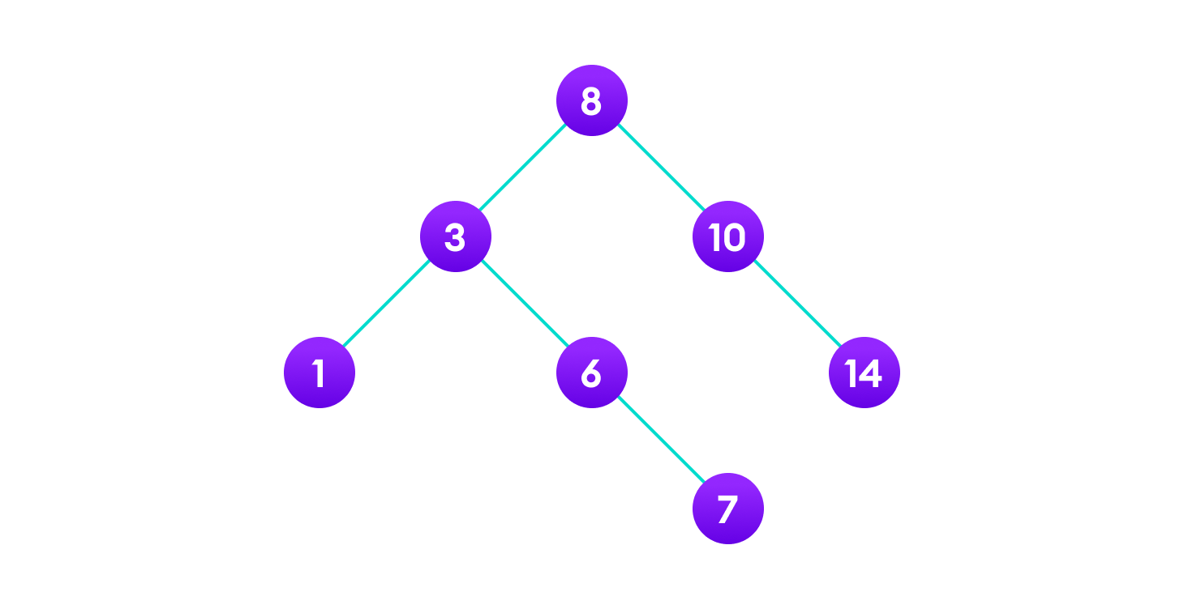
Deletion Operation There are three cases for deleting a node from a binary search tree. Case I In the first case, the node to be deleted is the leaf node. In such a case, simply delete the node from the tree.

Slide 20
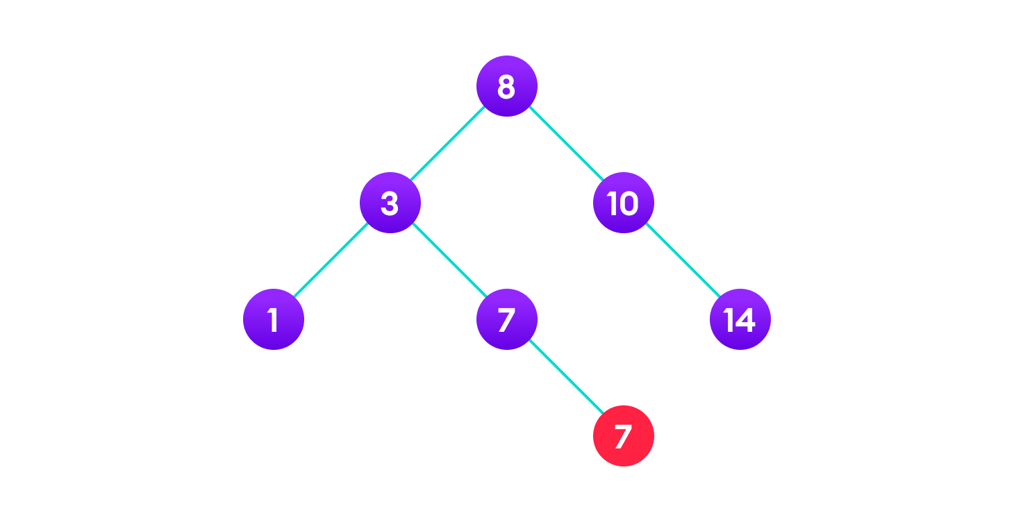
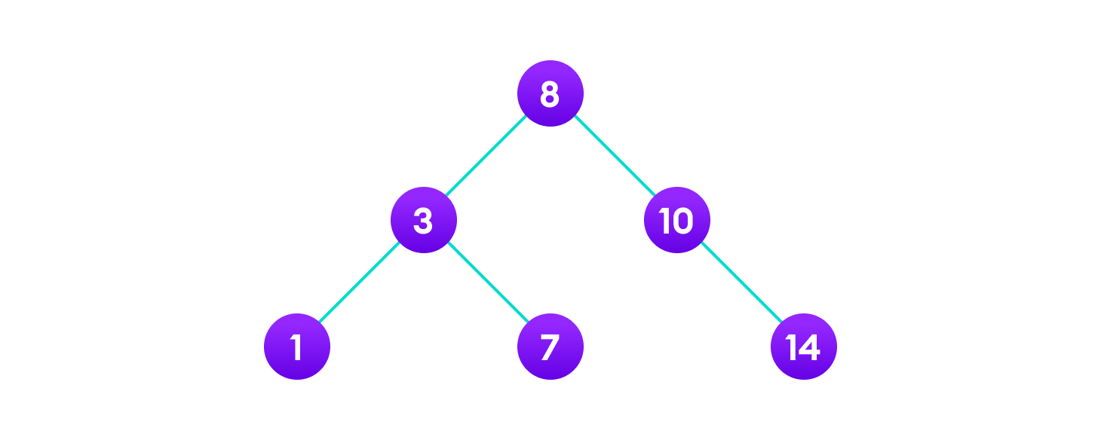
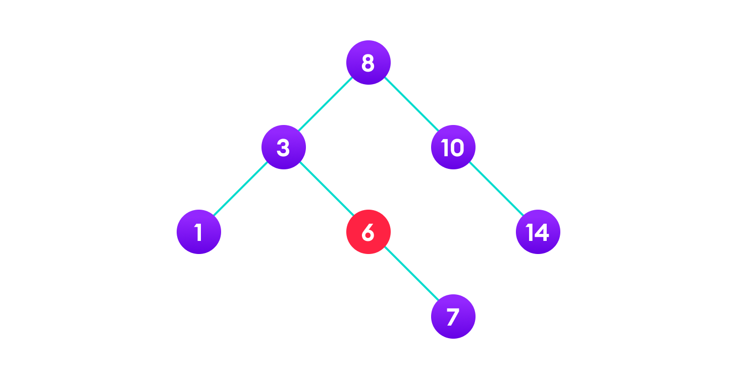
Case II In the second case, the node to be deleted lies has a single child node. In such a case follow the steps below: Replace that node with its child node. Remove the child node from its original position.

Slide 21
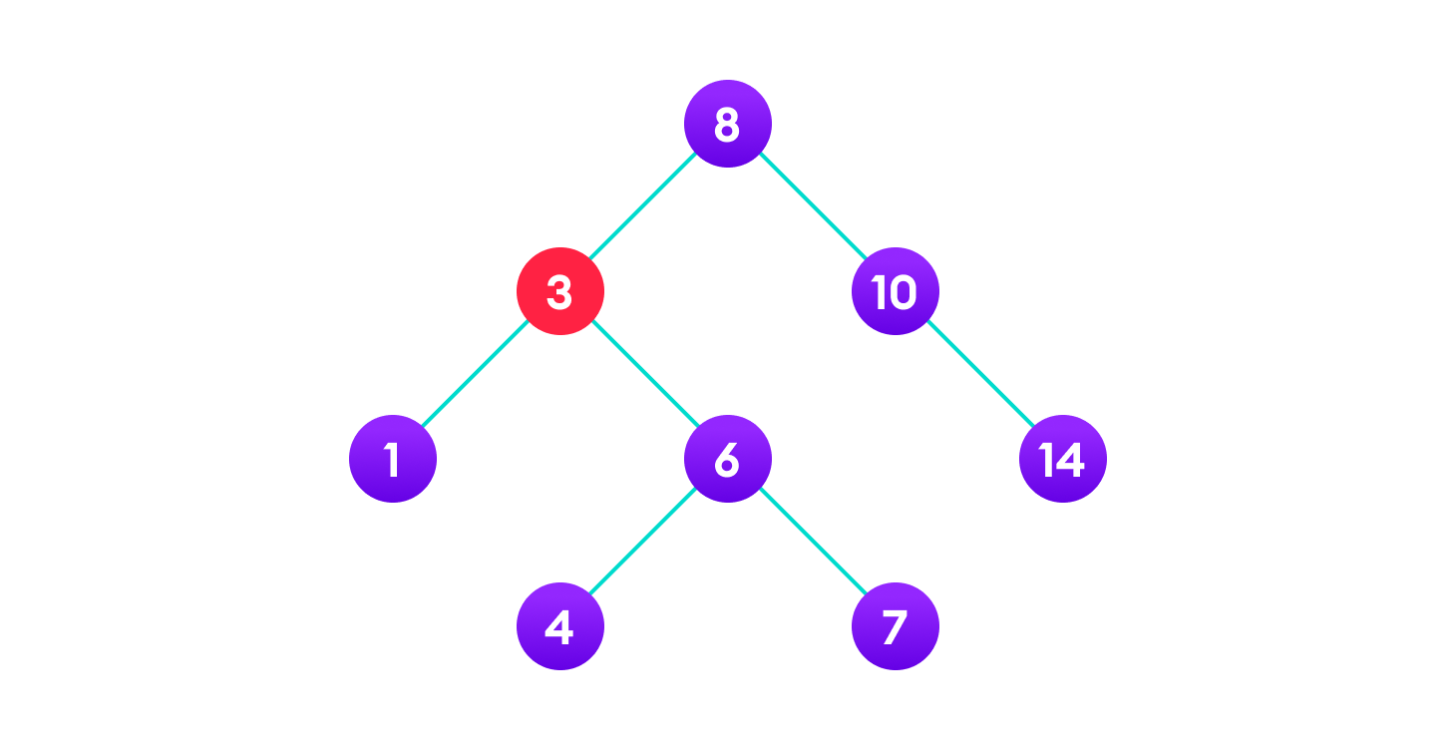

Case III In the third case, the node to be deleted has two children. In such a case follow the steps below: Get the inorder successor of that node. Replace the node with the inorder successor. Remove the inorder successor from its original position.

Slide 22
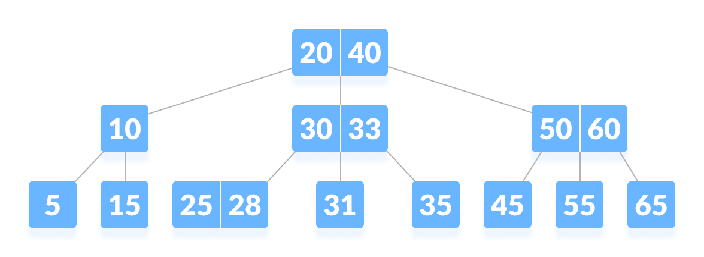
B-tree
B-tree is a special type of self-balancing search tree in which each node can contain more than one key and can have more than two children. It is a generalized form of the binary search tree.

Slide 23
B tree
A B tree of order m (m = 3)contains all the properties of an M way tree. In addition, it contains the following properties.
Every node in a B-Tree contains at most m(3) children.
Every node in a B-Tree except the root node and the leaf node contain at least m/2 (3/2 = 2)children.
A node can contain a maximum of m-1 keys i.e 2
A node (except root node) should contain a minimum of (m/2)-1 keys i.e 1 key
The root nodes must have at least 2 nodes.
All leaf nodes must be at the same level.
It is not necessary that, all the nodes contain the same number of children but, each node must have m/2 (2) number of nodes.

Slide 24
Order m
Maximum m nodes
Minimum m/2 nodes(children)
Keys
Maximum m-1 key
Minimum m/2 – 1 key

Slide 25
B-tree Properties
All leaves are at the same level.
The root has at least 2 children and contains a minimum of 1 key.
Each node except root can have at most n children and at least n/2 children.
All keys of a node are sorted in increasing order. The child between two keys k1 and k2 contains all keys in the range from k1 and k2.
B-Tree grows and shrinks from the root which is unlike Binary Search Tree. Binary Search Trees grow downward and also shrink from downward.
Like other balanced Binary Search Trees, time complexity to search, insert and delete is O(log n).
Insertion of a Node in B-Tree happens only at Leaf Node.

Slide 26
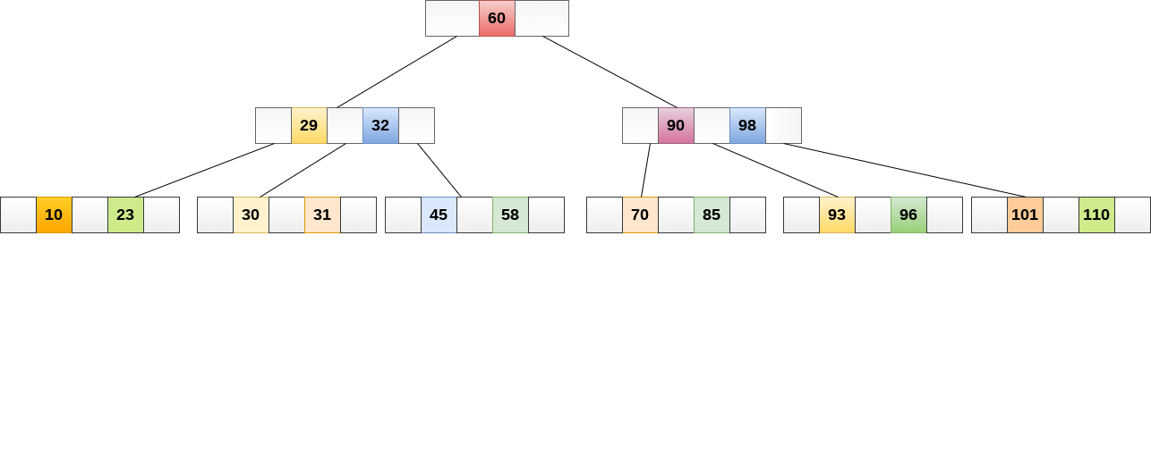
A B tree of order 3 is shown in the following image.

Slide 27
Create node in b-tree
# Create a node
class BTreeNode:
def __init__(self, leaf=False):
self.leaf = leaf
self.keys = []
self.child = []
# Tree
class BTree:
def __init__(self, t):
self.root = BTreeNode(True)
self.t = t

Slide 28
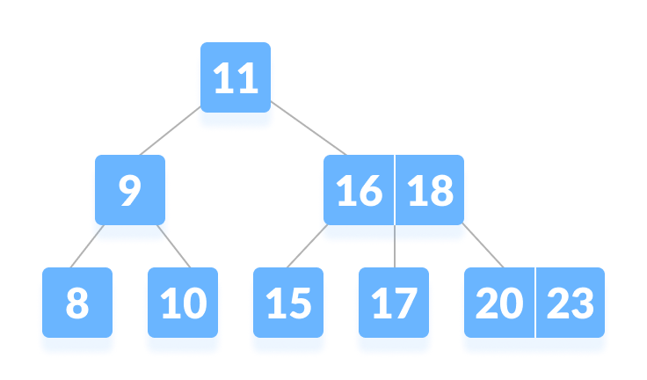
Searching an element in a B-tree

Slide 29
Searching in B tree
Searching
Step 1 - Read the search element from the user.
Step 2 - Compare the search element with first key value of root node in the tree.
Step 3 - If both are matched, then display "Given node is found!!!" and terminate the function
Step 4 - If both are not matched, then check whether search element is smaller or larger than that key value.
Step 5 - If search element is smaller, then continue the search process in left subtree.
Step 6 - If search element is larger, then compare the search element with next key value in the same node and
repeate steps 3, 4, 5 and 6 until we find the exact match or until the search element is compared with
last key value in the leaf node.
Step 7 - If the last key value in the leaf node is also not matched then display "Element is not found" and terminate the function.

Slide 30
Insertion into a B-tree
Inserting an element on a B-tree consists of two events: searching the appropriate node to insert the element and splitting the node if required. Insertion operation always takes place in the bottom-up approach.
Insertion Operation
If the tree is empty, allocate a root node and insert the key.
Update the allowed number of keys in the node.
Search the appropriate node for insertion.
If the node is full, follow the steps below.
Insert the elements in increasing order.
Now, there are elements greater than its limit. So, split at the median.
Push the median key upwards and make the left keys as a left child and the right keys as a right child.
If the node is not full, follow the steps below.
Insert the node in increasing order.

Slide 31
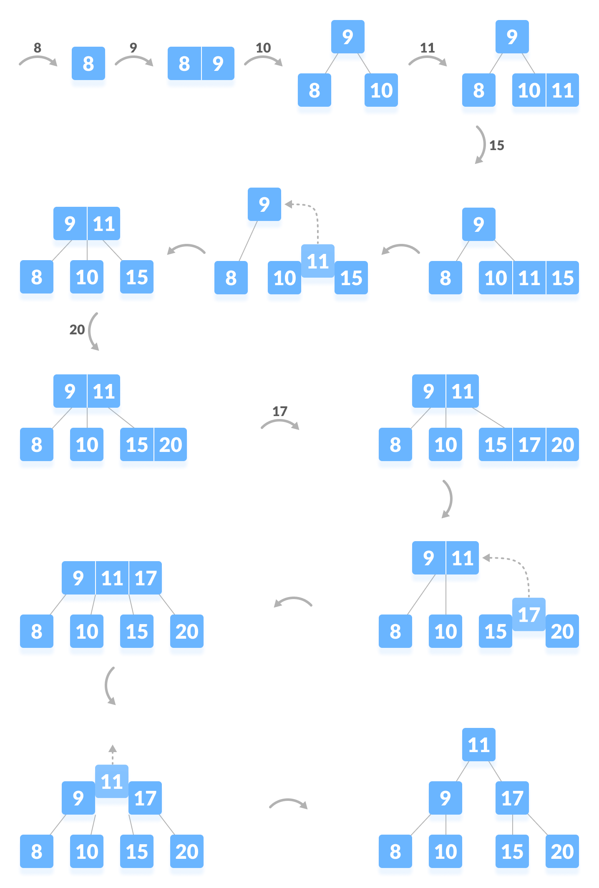

Slide 32
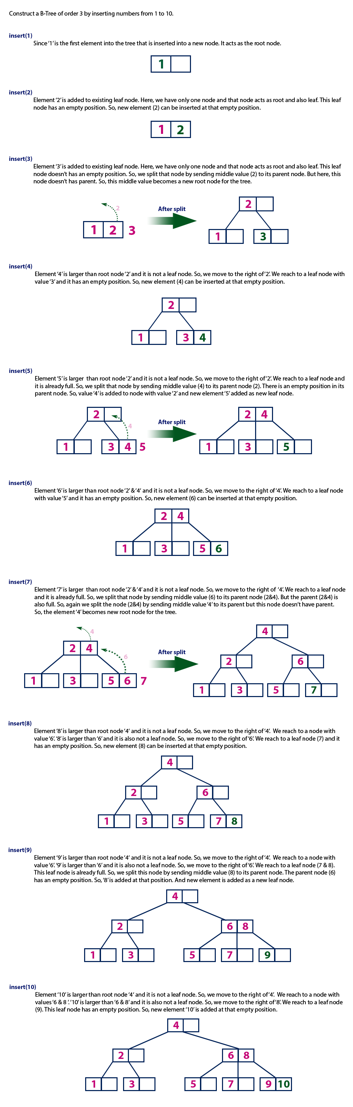

Slide 36
Deletion from a B-tree
Deleting an element on a B-tree consists of three main events: searching the node where the key to be deleted exists, deleting the key and balancing the tree if required.
While deleting a tree, a condition called underflow may occur. Underflow occurs when a node contains less than the minimum number of keys it should hold.
The terms to be understood before studying deletion operation are:
Inorder Predecessor The largest key on the left child of a node is called its inorder predecessor.
Inorder Successor The smallest key on the right child of a node is called its inorder successor.

Slide 37
Deletion Operation
There are three main cases for deletion operation in a B tree.
Case I
The key to be deleted lies in the leaf. There are two cases for it.
The deletion of the key does not violate the property of the minimum number of keys a node should hold. In the tree below, deleting 32 does not violate the above properties.

Slide 38
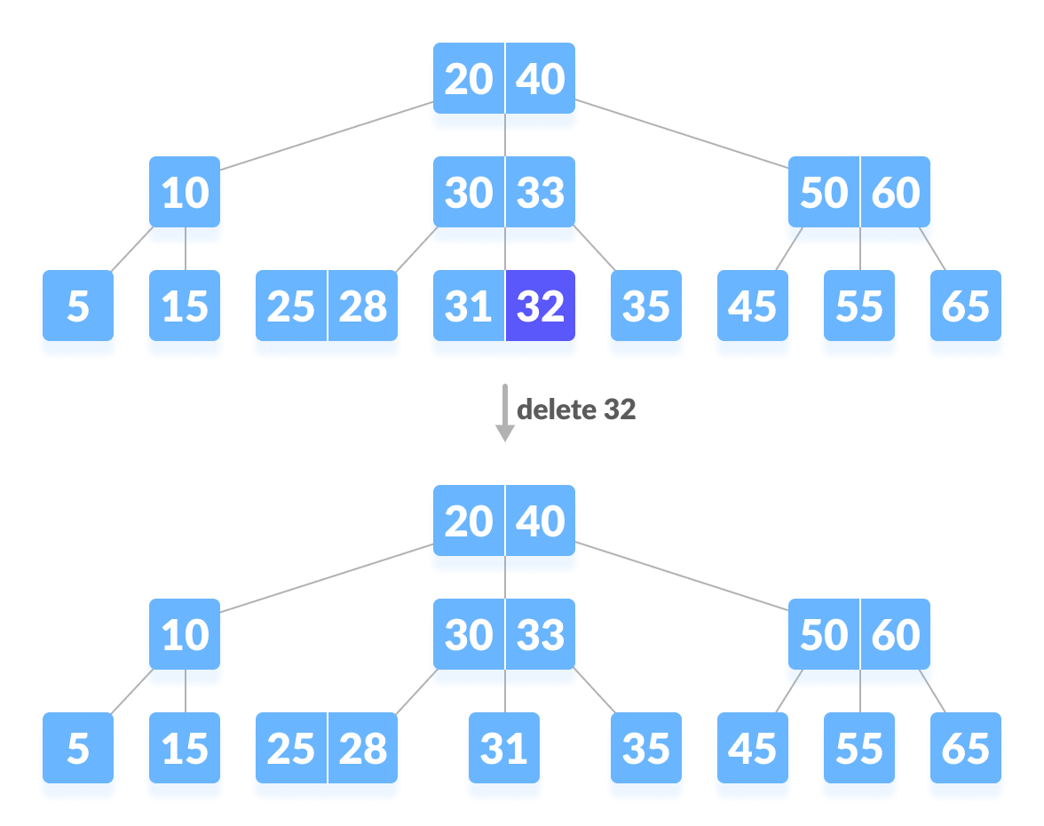

Slide 39
The deletion of the key violates the property of the minimum number of keys a node should hold. In this case, we borrow a key from its immediate neighboring sibling node in the order of left to right. First, visit the immediate left sibling. If the left sibling node has more than a minimum number of keys, then borrow a key from this node. Else, check to borrow from the immediate right sibling node. In the tree below, deleting 31 results in the above condition. Let us borrow a key from the left sibling node.

Slide 40
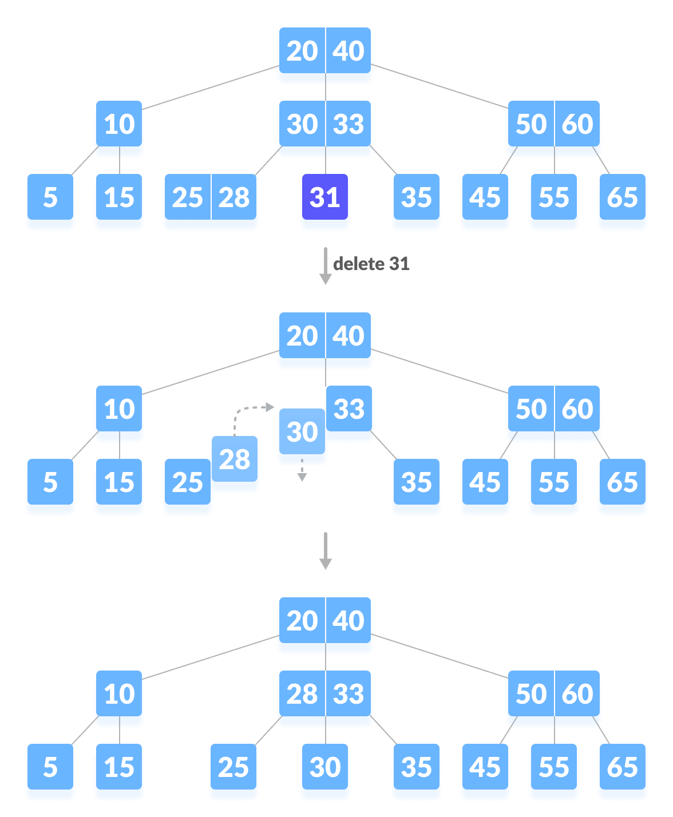

Slide 41
Case II
If the key to be deleted lies in the internal node, the following cases occur.
The internal node, which is deleted, is replaced by an inorder predecessor if the left child has more than the minimum number of keys.
The internal node, which is deleted, is replaced by an inorder successor if the right child has more than the minimum number of keys.
If either child has exactly a minimum number of keys then, merge the left and the right children.
After merging if the parent node has less than the minimum number of keys then, look for the siblings as in Case I.

Slide 42
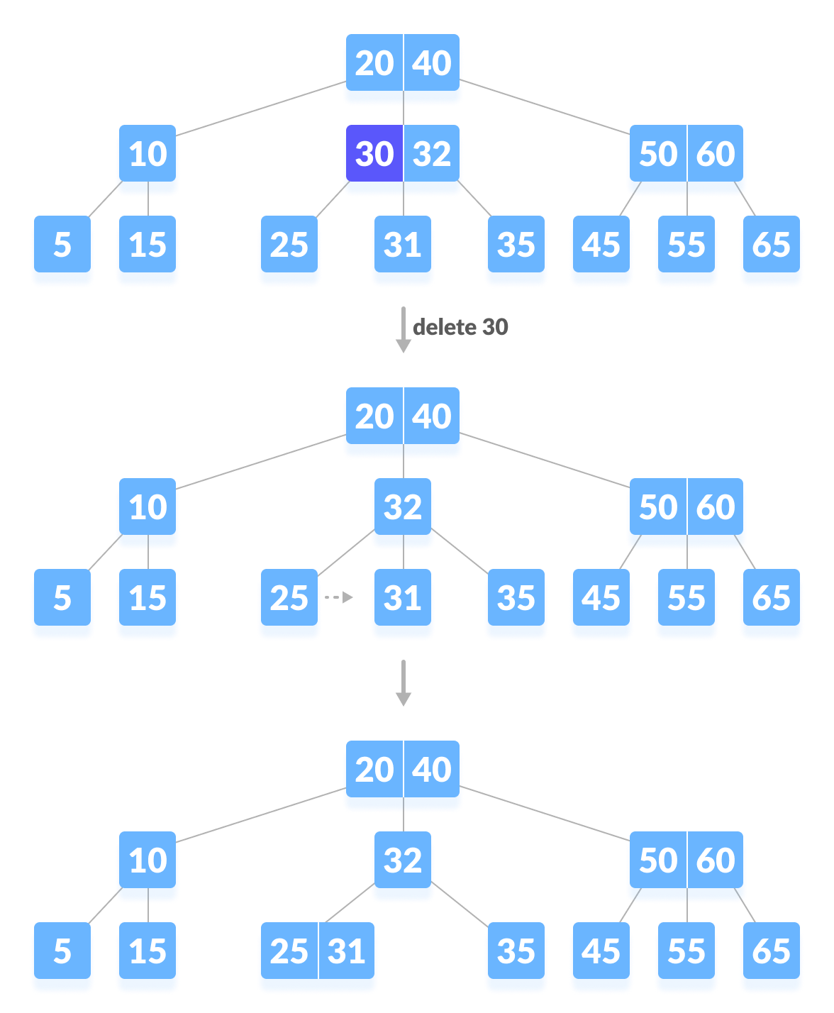

Slide 43
Case III
In this case, the height of the tree shrinks.
If the target key lies in an internal node, and the deletion of the key leads to a fewer number of keys in the node (i.e. less than the minimum required), then look for the inorder predecessor and the inorder successor.
If both the children contain a minimum number of keys then, borrowing cannot take place. This leads to Case II(3) i.e. merging the children.
Again, look for the sibling to borrow a key. But, if the sibling also has only a minimum number of keys then, merge the node with the sibling along with the parent. Arrange the children accordingly (increasing order).

Slide 44
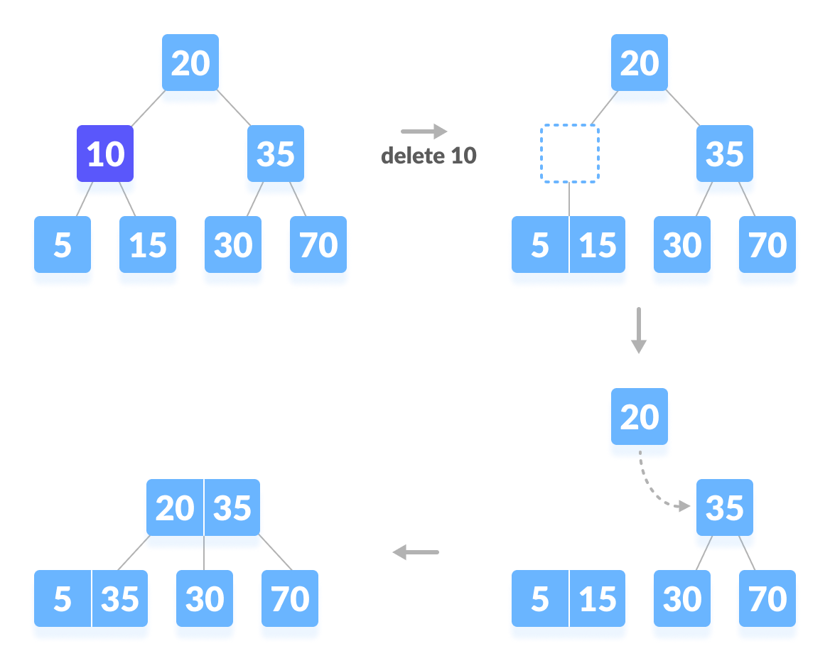

Slide 45
B+ Tree
In order, to implement dynamic multilevel indexing, B-tree and B+ tree are generally employed. The drawback of B-tree used for indexing, however is that it stores the data pointer (a pointer to the disk file block containing the key value), corresponding to a particular key value, along with that key value in the node of a B-tree. This technique, greatly reduces the number of entries that can be packed into a node of a B-tree, thereby contributing to the increase in the number of levels in the B-tree, hence increasing the search time of a record
B+ tree eliminates the above drawback by storing data pointers only at the leaf nodes of the tree. Thus, the structure of leaf nodes of a B+ tree is quite different from the structure of internal nodes of the B tree. It may be noted here that, since data pointers are present only at the leaf nodes, the leaf nodes must necessarily store all the key values along with their corresponding data pointers to the disk file block, in order to access them. Moreover, the leaf nodes are linked to provide ordered access to the records. The leaf nodes, therefore form the first level of index, with the internal nodes forming the other levels of a multilevel index. Some of the key values of the leaf nodes also appear in the internal nodes, to simply act as a medium to control the searching of a record.
From the above discussion it is apparent that a B+ tree, unlike a B-tree has two orders, ‘a’ and ‘b’, one for the internal nodes and the other for the external (or leaf) nodes.

Slide 46
B+ tree Properties
All leaves are at the same level.
The root has at least two children.
Max no keys a node can hold :- (m-1) 7-1 = 6
Max no children's a node can have :-(m) 7
Min Numb of keys a node can hold :- c(m/2) -1 = 4-1 = 3
Min no child :- m/2 = 4

Slide 47
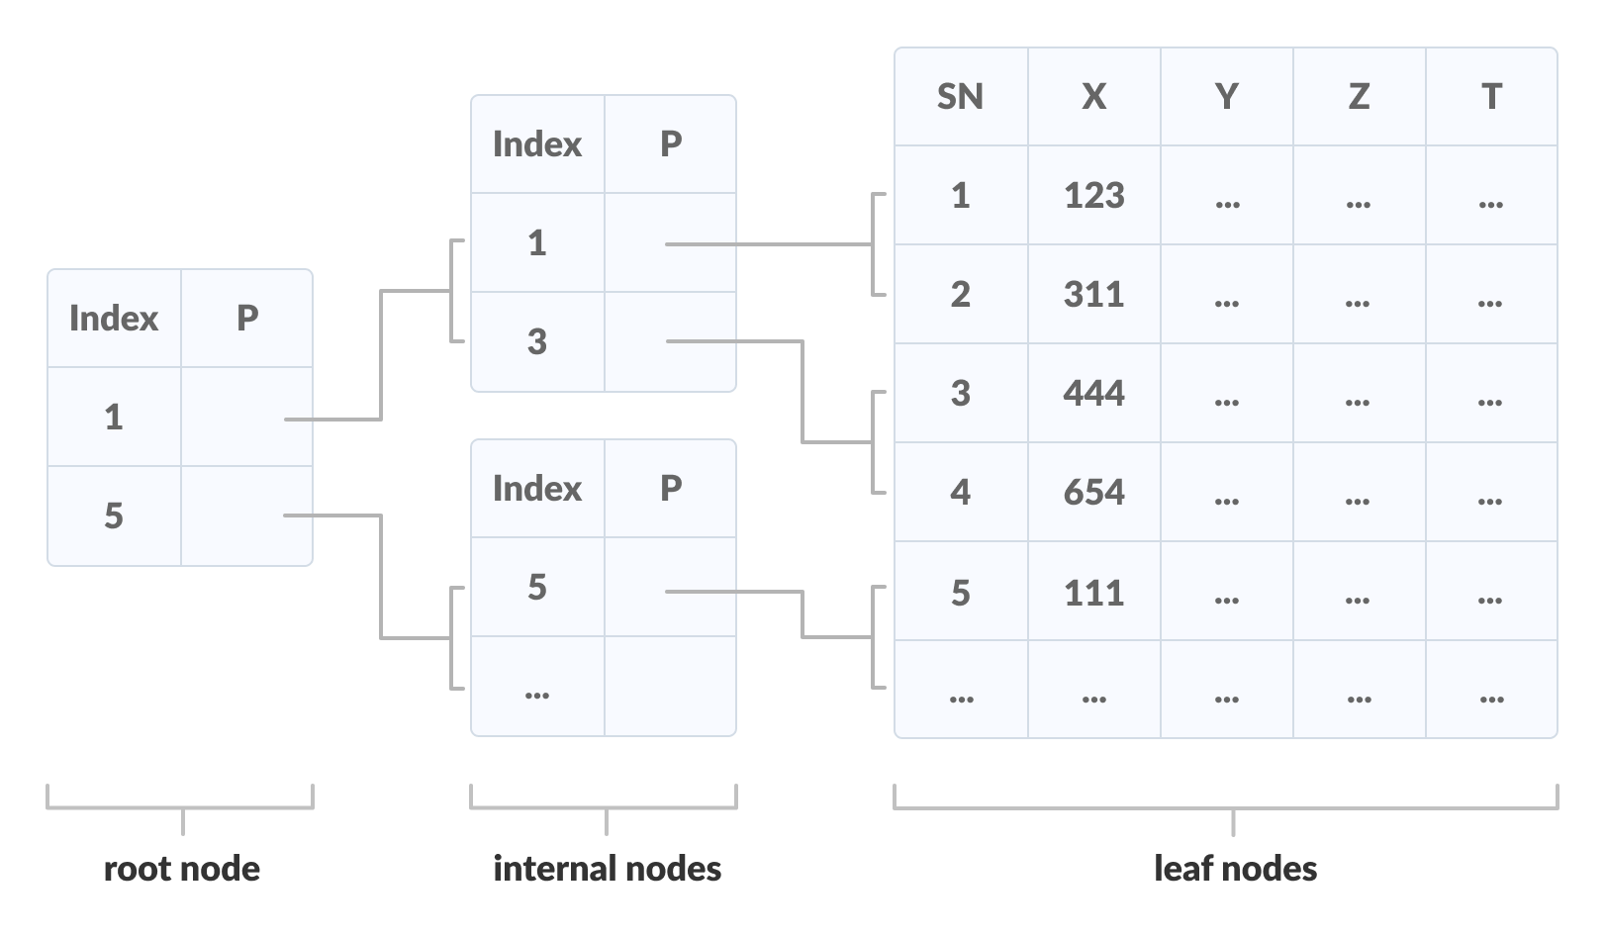
A B+ tree is an advanced form of a self-balancing tree in which all the values are present in the leaf level. An important concept to be understood before learning B+ tree is multilevel indexing. In multilevel indexing, the index of indices is created as in figure below. It makes accessing the data easier and faster.

Slide 48
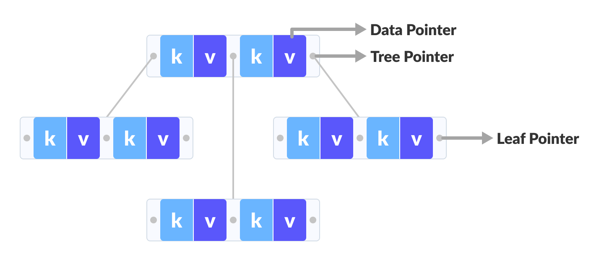
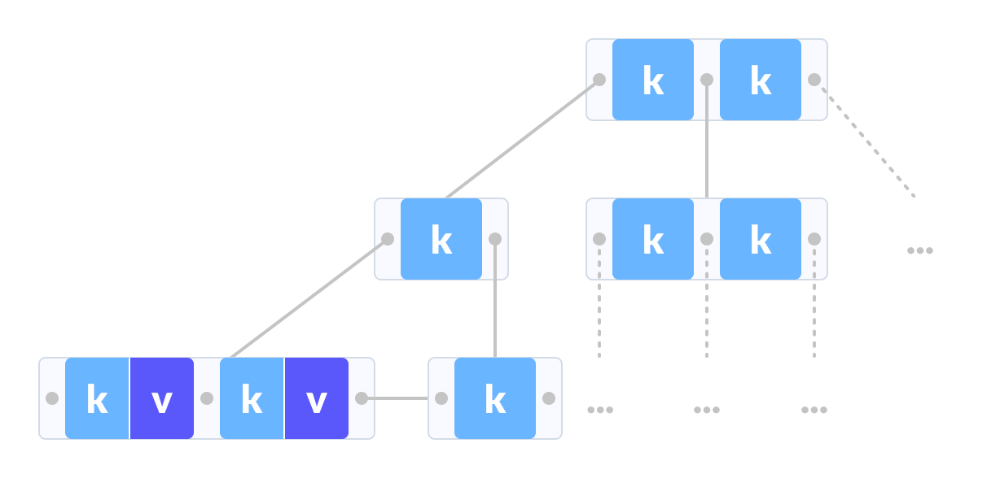
Comparison between a B-tree and a B+ Tree
B+ TREE
B TREE

Slide 49
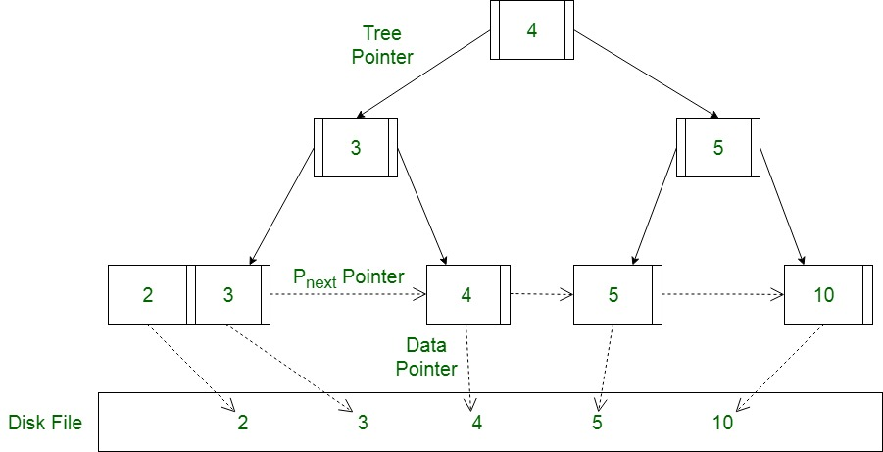
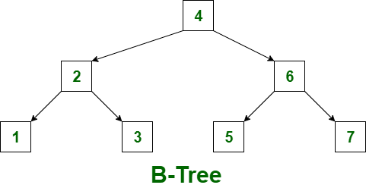
B tree and B+ tree

Slide 50
The data pointers are present only at the leaf nodes on a B+ tree whereas the data pointers are present in the internal, leaf or root nodes on a B-tree.
The leaves are not connected with each other on a B-tree whereas they are connected on a B+ tree.
Operations on a B+ tree are faster than on a B-tree.

Slide 51
A Diagram of B+ Tree

Slide 52
Searching on a B+ Tree
The following steps are followed to search for data in a B+ Tree of order m.
Let the data to be searched be k.
Start from the root node. Compare k with the keys at the root node [k1, k2, k3,......km - 1].
If k < k1, go to the left child of the root node.
Else if k > k1, compare k2. If k < k2, k lies between k1 and k2. So, search in the left child of k2.
If k > k2, go for k3, k4,...km-1 as in steps 2 and 3.
Repeat the above steps until a leaf node is reached.
If k exists in the leaf node, return true else return false.

Slide 53
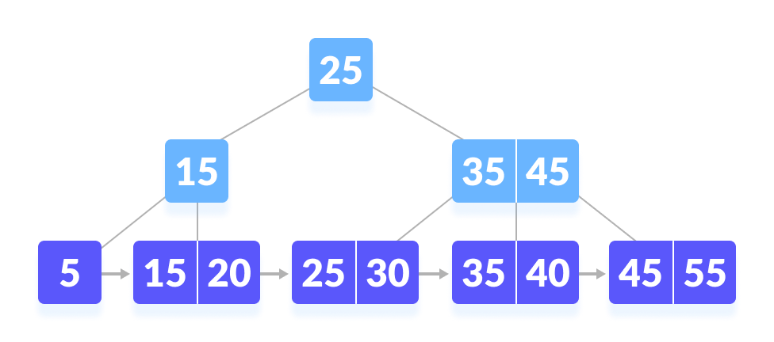
Let us search k = 45 on the following B+ tree.

Slide 54
Insertion Operation
The following steps are followed for inserting an element.
Since every element is inserted into the leaf node, go to the appropriate leaf node.
Insert the key into the leaf node.
Case I
If the leaf is not full, insert the key into the leaf node in increasing order.
Case II
If the leaf is full, insert the key into the leaf node in increasing order and balance the tree in the following way.
Break the node at m/2th position.
Add m/2th key to the parent node as well.
If the parent node is already full, follow steps 2 to 3.

Slide 55

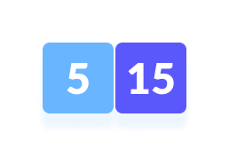
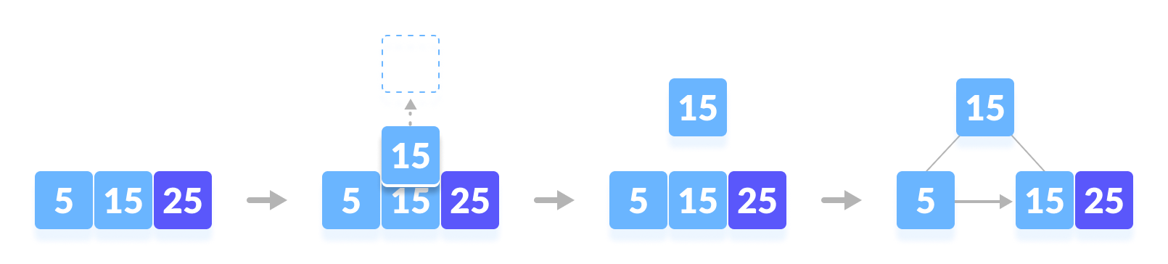
INSERT 5
INSERT 15
INSERT 25

Slide 56
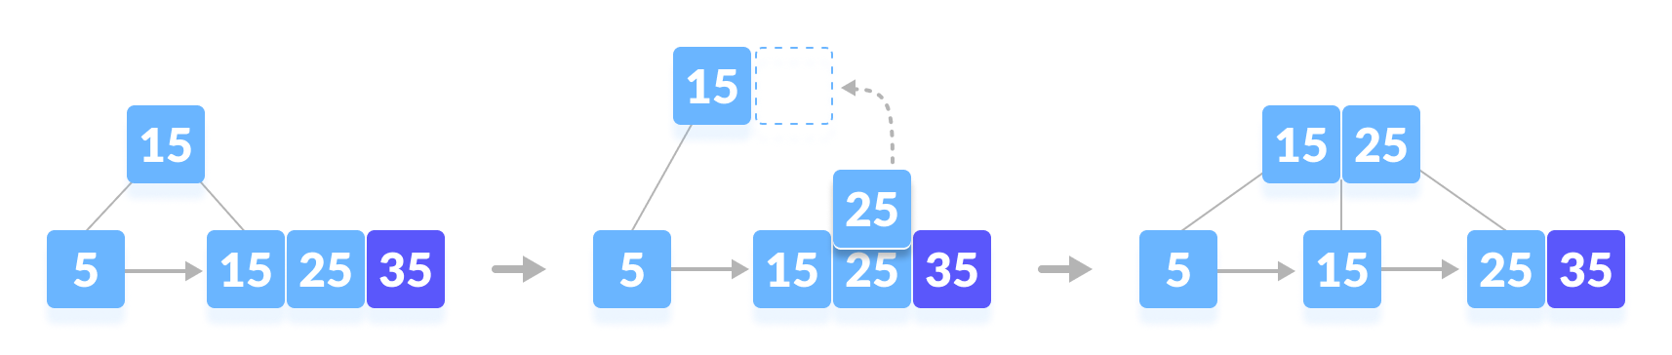
INSERT 35

Slide 57
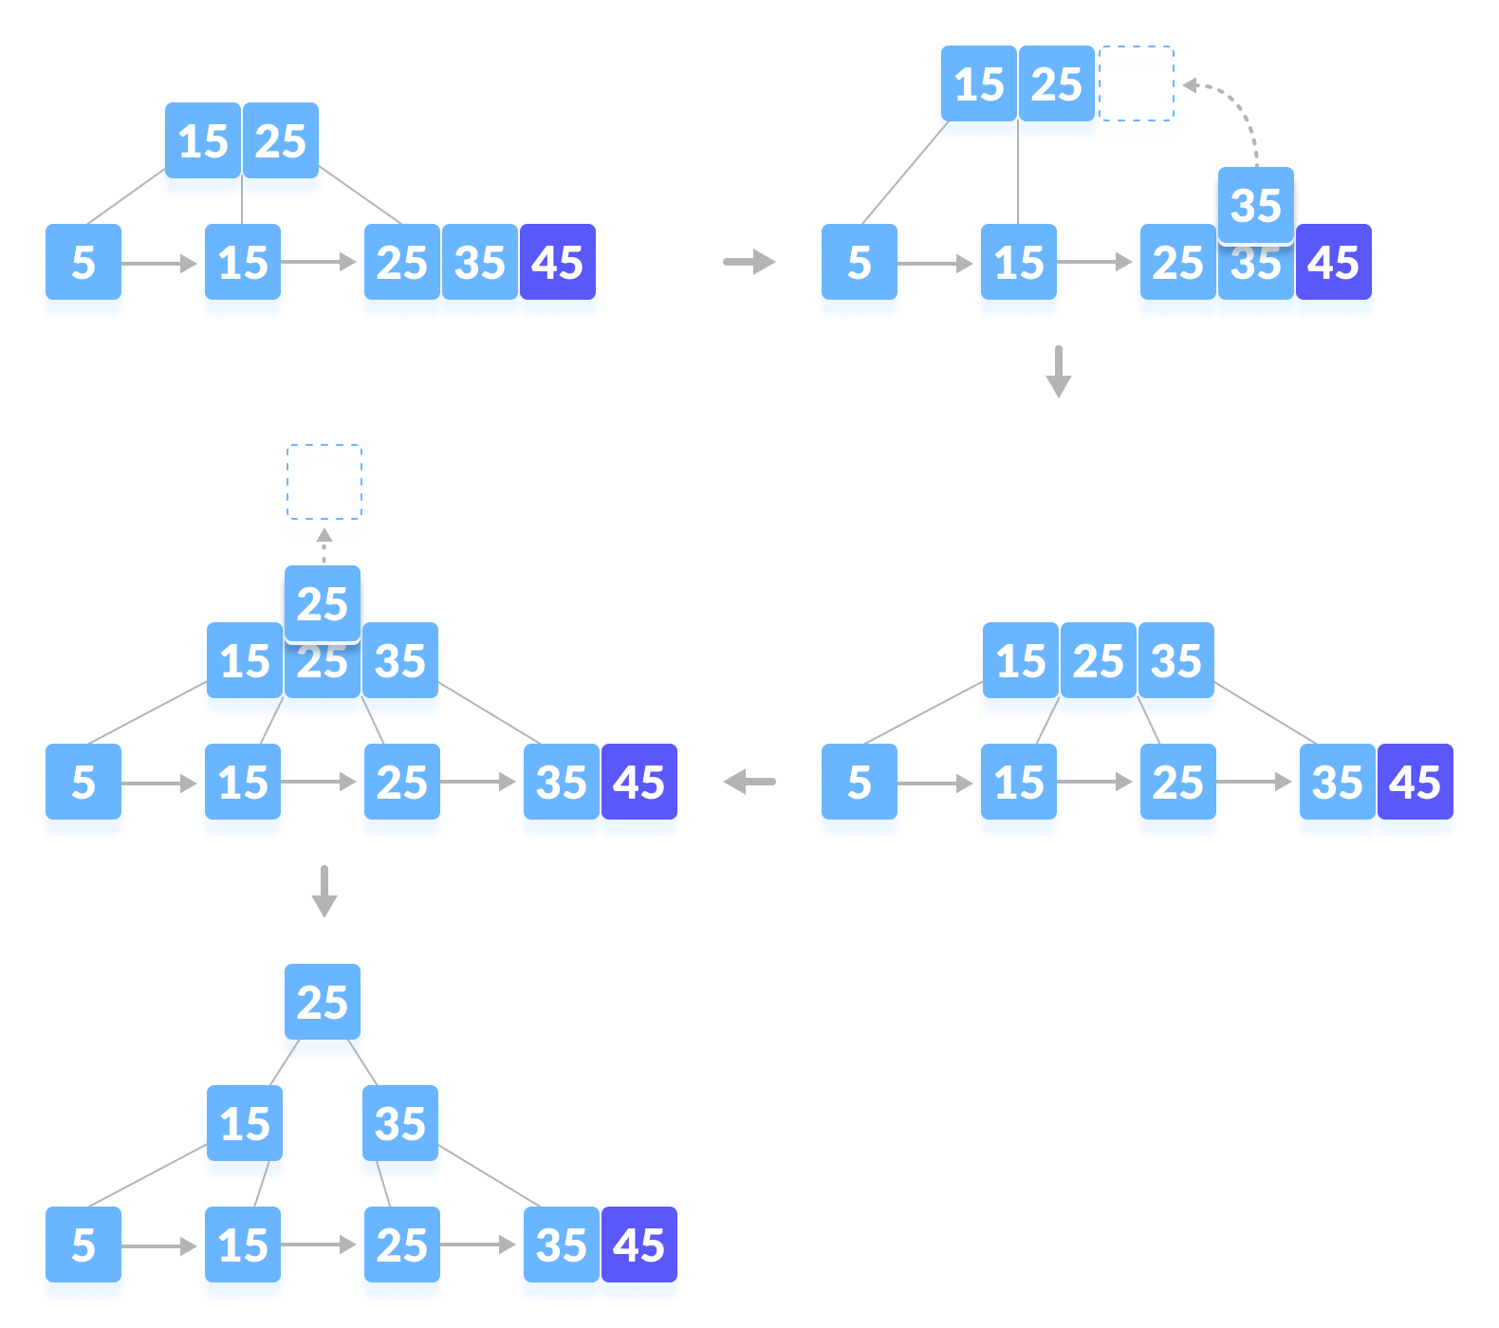
INSERT 45

Slide 58
Deletion from a B+ Tree
Deleting an element on a B+ tree consists of three main events: searching the node where the key to be deleted exists, deleting the key and balancing the tree if required.
Underflow is a situation when there is less number of keys in a node than the minimum number of keys it should hold.

Slide 59
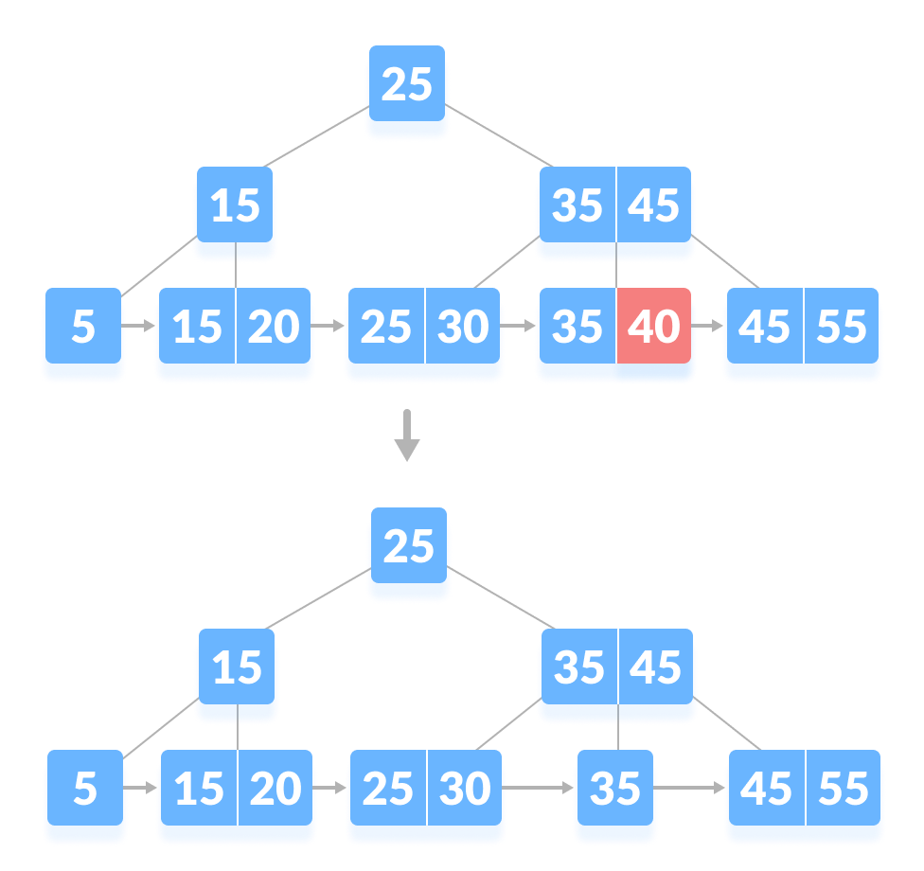
Deletion Operation
While deleting a key, we have to take care of the keys present in the internal nodes (i.e. indexes) as well because the values are redundant in a B+ tree. Search the key to be deleted then follow the following steps.
Case I:
The key to be deleted is present only at the leaf node not in the indexes (or internal nodes). There are two cases for it:
There is more than the minimum number of keys in the node. Simply delete the key.

Slide 60
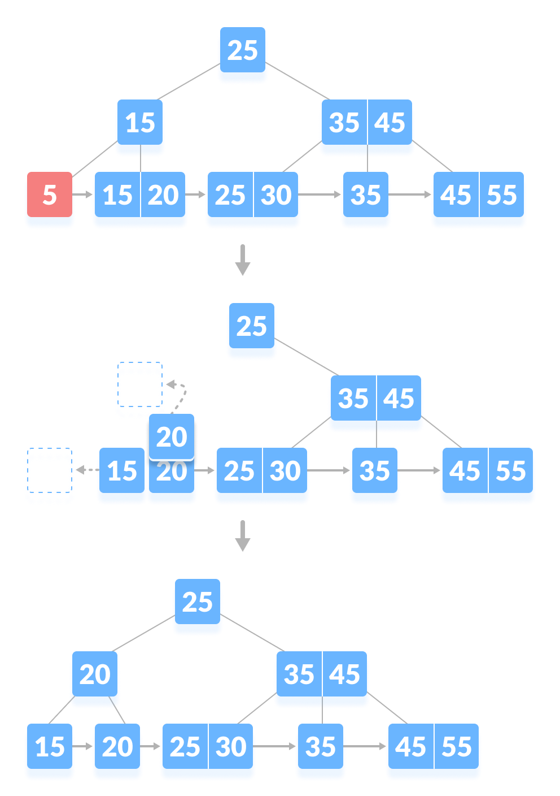
There is an exact minimum number of keys in the node. Delete the key and borrow a key from the immediate sibling. Add the median key of the sibling node to the parent.

Slide 61
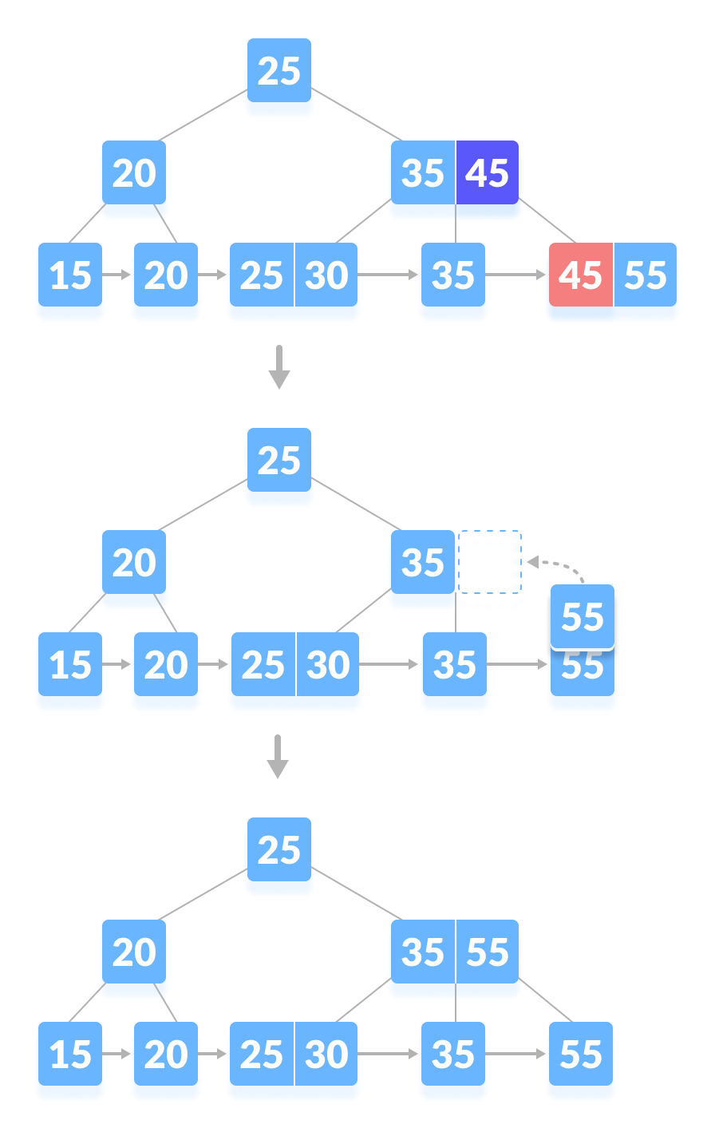
Case II
The key to be deleted is present in the internal nodes as well. Then we have to remove them from the internal nodes as well. There are the following cases for this situation.
If there is more than the minimum number of keys in the node, simply delete the key from the leaf node and delete the key from the internal node as well. Fill the empty space in the internal node with the inorder successor.

Slide 62
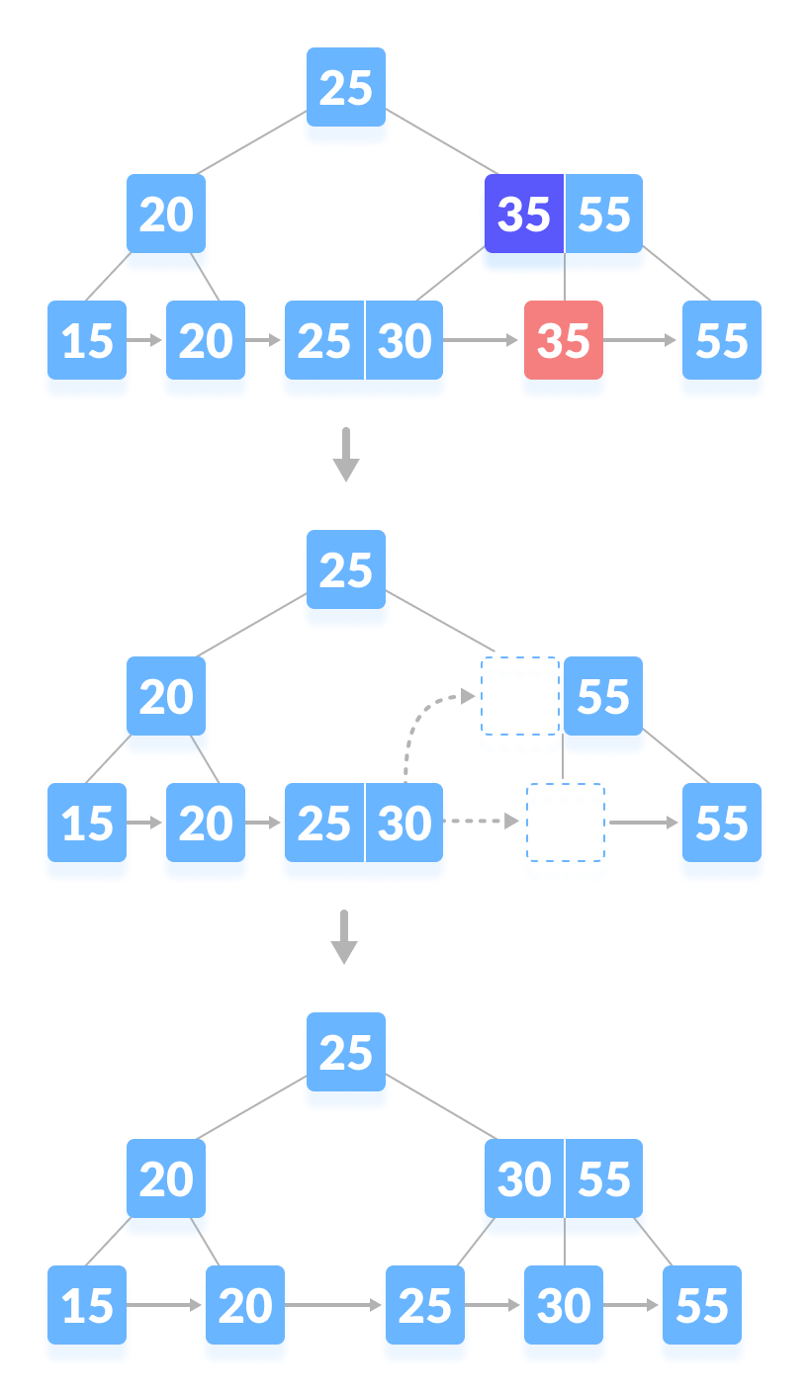
If there is an exact minimum number of keys in the node, then delete the key and borrow a key from its immediate sibling (through the parent). Fill the empty space created in the index (internal node) with the borrowed key.

Slide 63
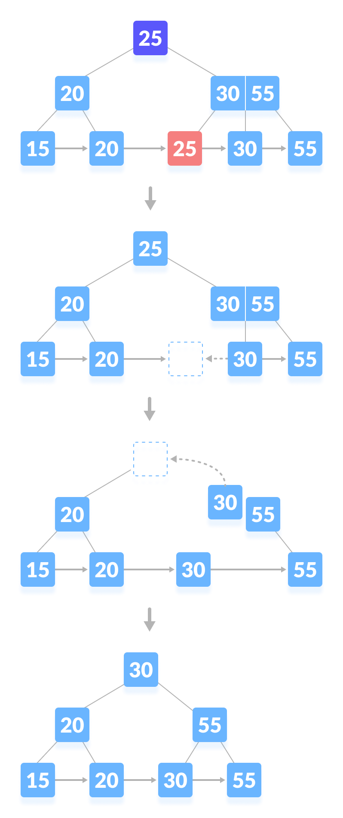
This case is similar to Case II(1) but here, empty space is generated above the immediate parent node. After deleting the key, merge the empty space with its sibling. Fill the empty space in the grandparent node with the inorder successor.

Slide 64
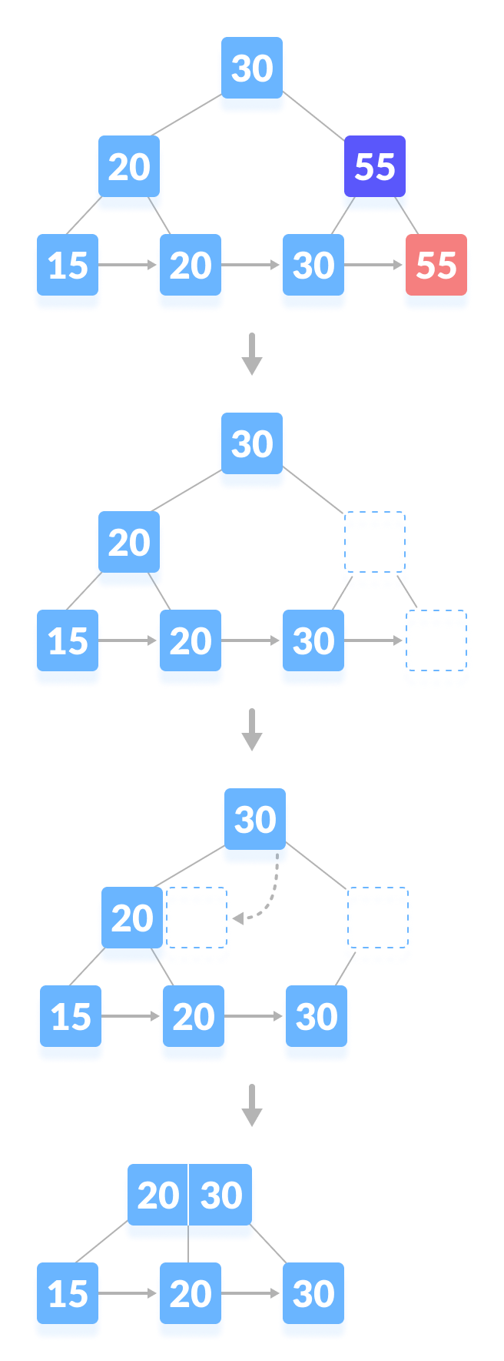
Case III
In this case, the height of the tree gets shrinked . It is a little complicated . Deleting 55 from the tree below leads to this condition. It can be understood in the illustrations below.

Slide 65
Advantage
Records can be fetched in equal number of disk accesses.
Height of the tree remains balanced and less as compare to B tree.
We can access the data stored in a B+ tree sequentially as well as directly.
Keys are used for indexing.
Faster search queries as the data is stored only on the leaf nodes.
Multilevel Indexing
Faster operations on the tree (insertion, deletion, search)
Database indexing

Slide 66
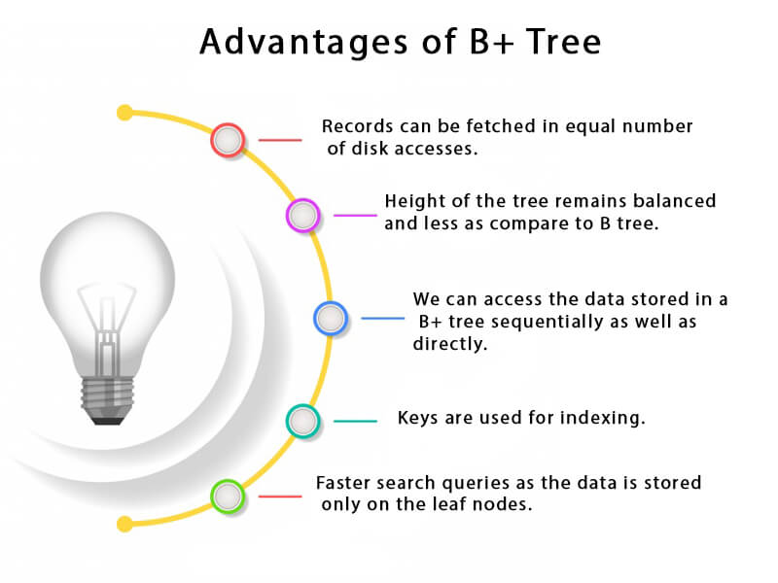

Slide 67
Let’s see the difference between B-tree and B+ tree:
S.NO | B tree | B+ tree
1. | All internal and leaf nodes have data pointers | Only leaf nodes have data pointers
2. | Since all keys are not available at leaf, search often takes more time. | All keys are at leaf nodes, hence search is faster and accurate..
3. | No duplicate of keys is maintained in the tree. | Duplicate of keys are maintained and all nodes are present at leaf.
4. | Insertion takes more time and it is not predictable sometimes. | Insertion is easier and the results are always the same.
5. | Deletion of internal node is very complex and tree has to undergo lot of transformations. | Deletion of any node is easy because all node are found at leaf.
6. | Leaf nodes are not stored as structural linked list. | Leaf nodes are stored as structural linked list.
7. | No redundant search keys are present.. | Redundant search keys may be present..

Slide 68
Red-Black Tree
Red-Black tree is a self-balancing binary search tree in which each node contains an extra bit for denoting the color of the node, either red or black.
A red-black tree satisfies the following properties:
Red - Black Tree must be a Binary Search Tree.
Red/Black Property: Every node is colored, either red or black.
Root Property: The root is black.
Leaf Property: Every leaf (NIL) is black.
Red Property: If a red node has children then, the children are always black.
Depth Property: For each node, any simple path from this node to any of its descendant leaf has the same black-depth (the number of black nodes).

Slide 69
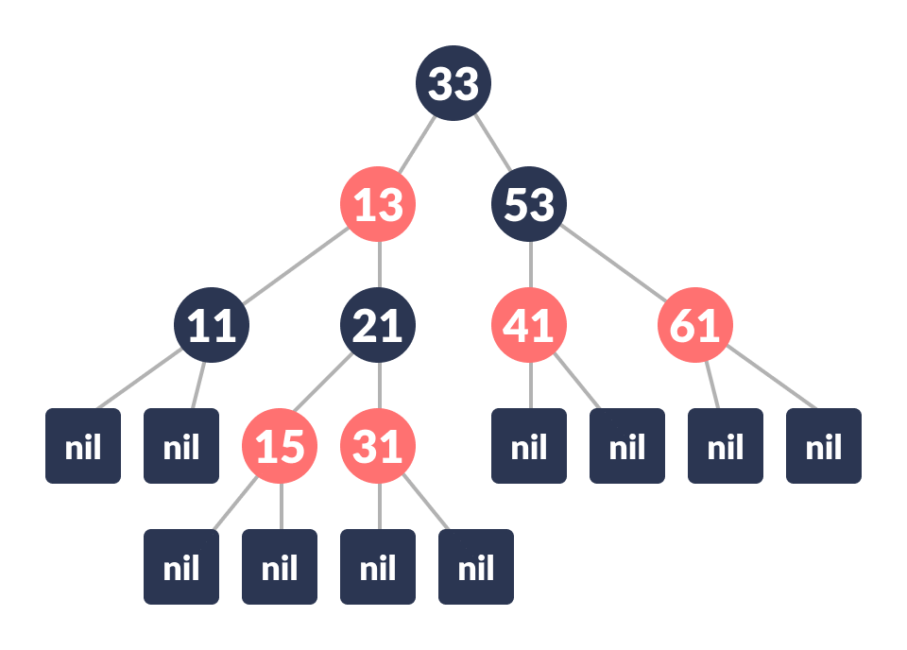
Each node has the following attributes:
Color
Key
Left Child
Right Child
Parent (except root node)

Slide 70
Search Operation in Red-black Tree:
As every red-black tree is a special case of a binary tree so the searching algorithm of a red-black tree is similar to that of a binary tree.
searchElement (tree, val)
Step 1: If tree -> data = val OR tree = NULL
Return tree
Else If val < data
Return searchElement (tree -> left, val)
Else
Return searchElement (tree -> right, val)
[ End of if ]
Step 2: END

Slide 71
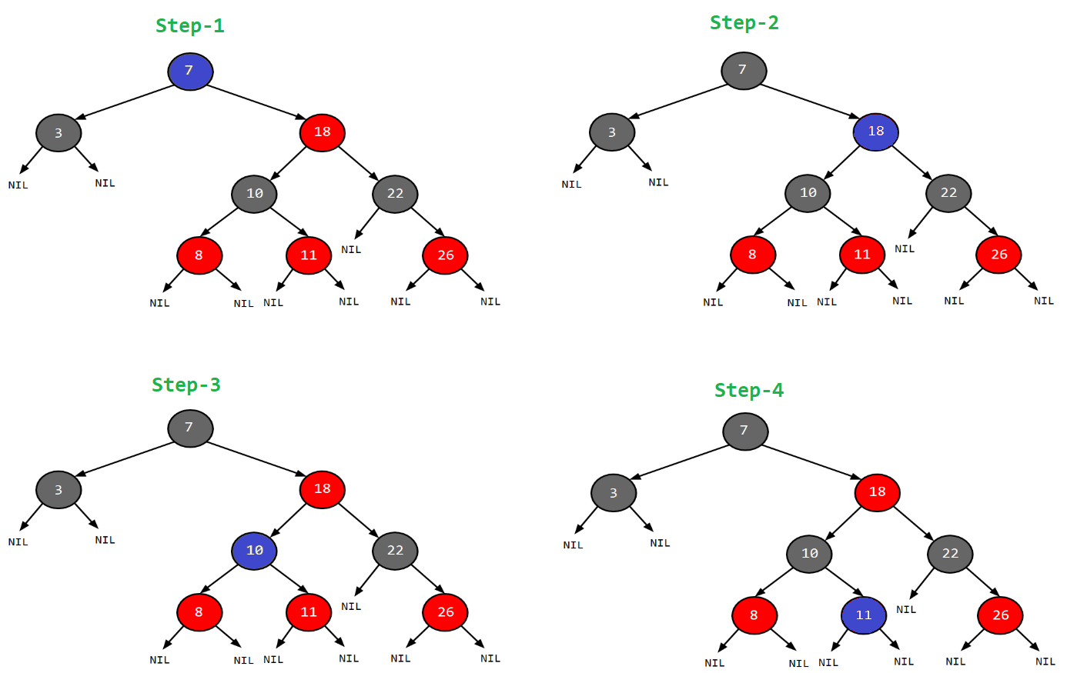

Slide 72
Operations on a Red-Black Tree
Various operations that can be performed on a red-black tree are:
Rotating the subtrees in a Red-Black Tree
In rotation operation, the positions of the nodes of a subtree are interchanged.
Rotation operation is used for maintaining the properties of a red-black tree when they are violated by other operations such as insertion and deletion.
There are two types of rotations: Left rotation and Right rotation

Slide 73
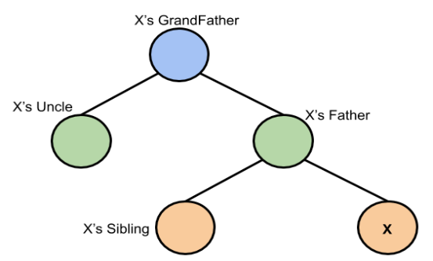
Logic:
First, you have to insert the node similarly to that in a binary tree and assign a red colour to it. Now, if the node is a root node then change its colour to black, but if it does not then check the colour of the parent node. If its colour is black then don’t change the colour but if it is not i.e. it is red then check the colour of the node’s uncle. If the node’s uncle has a red colour then change the colour of the node’s parent and uncle to black and that of grandfather to red colour and repeat the same process for him (i.e. grandfather).

Slide 74



GRANDPA
UNCLE
BLACK = CALM
RED = ANGRY
FATHER

Slide 75
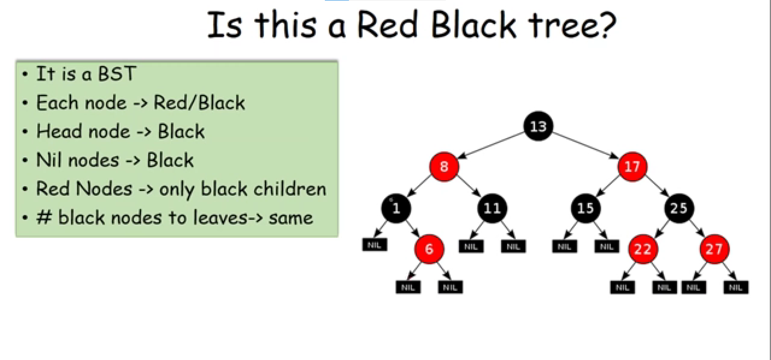

Slide 76
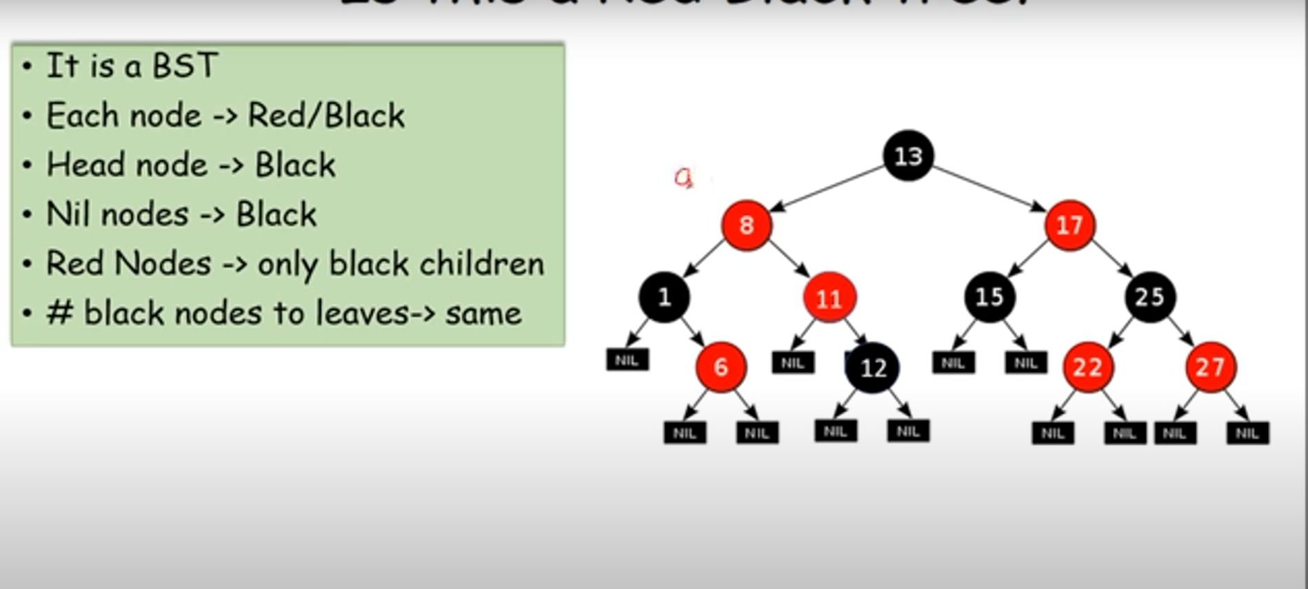

Slide 77
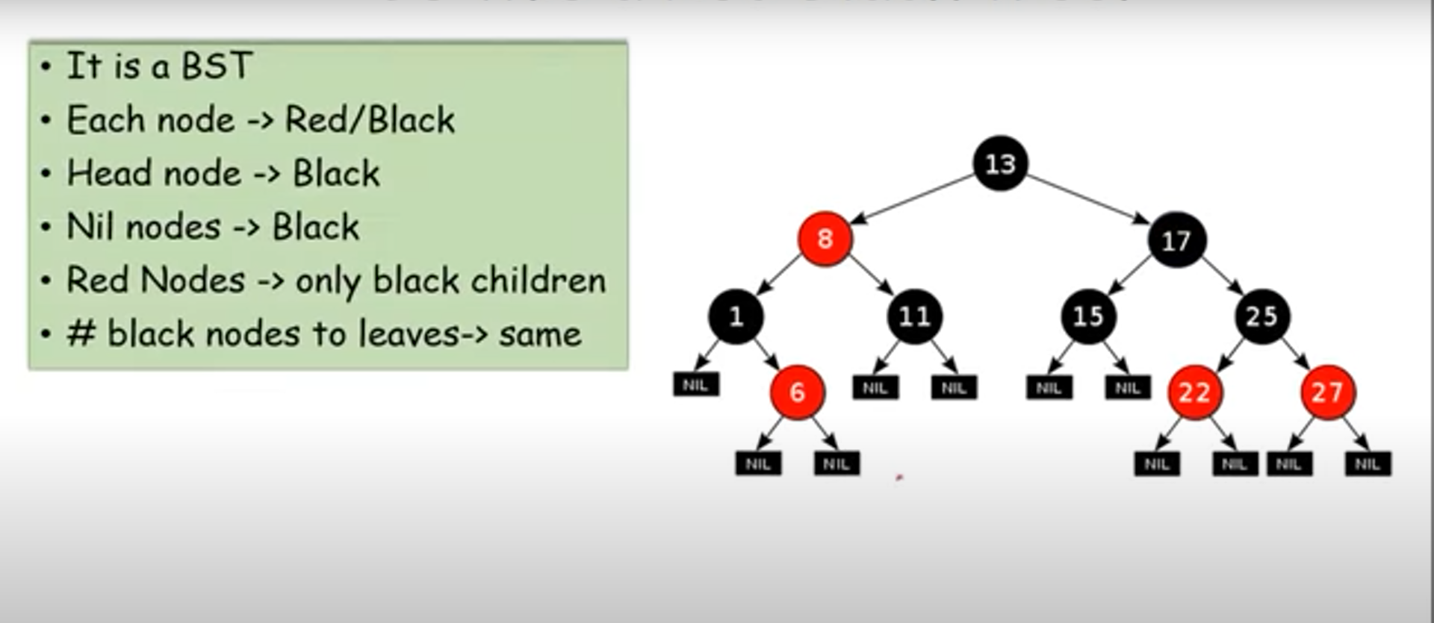

Slide 78

THINGS TO REMEMBER
Z IS ALWAYS RED DURING INSERTION
AFTER OPERATION -> NEW Z IS LOWEST NODE IN VOILATION
PRIORITY IS GIVEN TO PARENT THAN CHILD DURING ROTATION

Slide 79
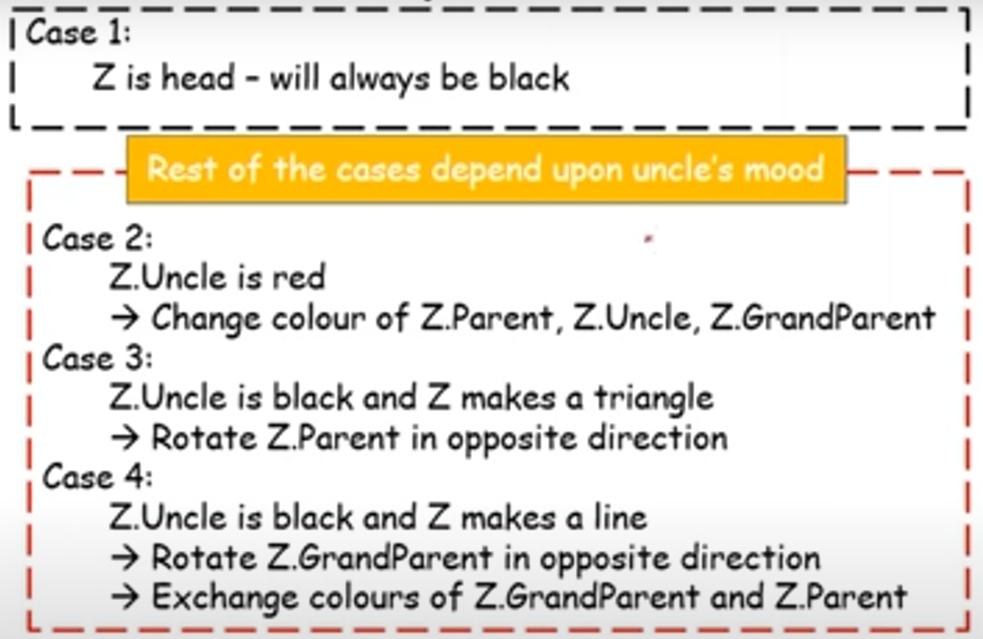

Slide 80


Slide 81


Slide 82



Slide 83


Slide 84




Slide 85


Slide 86

But, if the node’s uncle has black colour then there are 4 possible cases:
Left Left Case (LL rotation):

Slide 87

Left Right Case (LR rotation):

Slide 88

Right Right Case (RR rotation):

Slide 89

Right Left Case (RL rotation):

Slide 90
Insertion in Red-Black Tree
In a Red-Black Tree, every new node must be inserted with the color RED. The insertion operation in Red Black Tree is similar to insertion operation in Binary Search Tree. But it is inserted with a color property. After every insertion operation, we need to check all the properties of Red-Black Tree. If all the properties are satisfied then we go to next operation otherwise we perform the following operation to make it Red Black Tree.
1. Recolor
2. Rotation
3. Rotation followed by Recolor
The insertion operation in Red Black tree is performed using the following steps...
Step 1 - Check whether tree is Empty.
Step 2 - If tree is Empty then insert the newNode as Root node with color Black and exit from the operation.
Step 3 - If tree is not Empty then insert the newNode as leaf node with color Red.
Step 4 - If the parent of newNode is Black then exit from the operation.
Step 5 - If the parent of newNode is Red then check the color of parentnode's sibling of newNode.
Step 6 - If it is colored Black or NULL then make suitable Rotation and Recolor it.
Step 7 - If it is colored Red then perform Recolor. Repeat the same until tree becomes Red Black Tree.

Slide 91


Slide 97
4
7
12
15
3
5
14
18
16
17
CREATE A RED-BLACK TREE USING THESE NODES.

Slide 98
Deletion in Red-Black Tree
Insertion Vs Deletion: Like Insertion, recoloring and rotations are used to maintain the Red-Black properties. In the insert operation, we check the color of the uncle to decide the appropriate case. In the delete operation, we check the color of the sibling to decide the appropriate case. The main property that violates after insertion is two consecutive reds. In delete, the main violated property is, change of black height in subtrees as deletion of a black node may cause reduced black height in one root to leaf path. Deletion is a fairly complex process. To understand deletion, the notion of double black is used. When a black node is deleted and replaced by a black child, the child is marked as double black. The main task now becomes to convert this double black to single black.
The deletion operation in Red-Black Tree is similar to deletion operation in BST. But after every deletion operation, we need to check with the Red-Black Tree properties. If any of the properties are violated then make suitable operations like Recolor, Rotation and Rotation followed by Recolor to make it Red-Black Tree.

Slide 99
RED – CRYING/ANGRY
BLACK – CALM + 1 GOLD COIN
D BLACK – UNCLE HAVING 2 GOLD COINS
DB NODE OBSERVATION :
PARENT – INLINE CHILD – TRIANGLE CHILD
GOLD COIN CAN ONLY TRAVEL UPWARDS
WHOEVER EXPLAINS SWAPS COLOUR AND ROTATES
FATHER AWAY FROM UNCLE
GRANDFATHER TOWARDS UNCLE

Slide 100


Slide 101



Slide 102








Slide 103




Slide 104



Slide 105








13
14

Slide 106




Slide 107





10

Slide 108



Slide 109

INSERT : 10,20,30,40,50,60,70,80,90,100
DELETE : 50,20,100,90,40,60,30,10,70,80
40
20
60
10
30
50
80
70
90
100

Slide 110

Deletion Steps
Following are detailed steps for deletion. 1) Perform standard BST delete. When we perform standard delete operation in BST, we always end up deleting a node which is an either leaf or has only one child (For an internal node, we copy the successor and then recursively call delete for successor, successor is always a leaf node or a node with one child). So we only need to handle cases where a node is leaf or has one child. Let v be the node to be deleted and u be the child that replaces v (Note that u is NULL when v is a leaf and color of NULL is considered as Black).
2) Simple Case: If either u or v is red, we mark the replaced child as black (No change in black height). Note that both u and v cannot be red as v is parent of u and two consecutive reds are not allowed in red-black tree.

Slide 111

3) If Both u and v are Black. 3.1) Color u as double black. Now our task reduces to convert this double black to single black. Note that If v is leaf, then u is NULL and color of NULL is considered black. So the deletion of a black leaf also causes a double black.

Slide 112

3.2) Do following while the current node u is double black, and it is not the root. Let sibling of node be s. ….(a): If sibling s is black and at least one of sibling’s children is red, perform rotation(s). Let the red child of s be r. This case can be divided in four subcases depending upon positions of s and r. …………..(i) Left Left Case (s is left child of its parent and r is left child of s or both children of s are red). This is mirror of right right case shown in below diagram. …………..(ii) Left Right Case (s is left child of its parent and r is right child). This is mirror of right left case shown in below diagram. …………..(iii) Right Right Case (s is right child of its parent and r is right child of s or both children of s are red)

Slide 113

Right Left Case (s is right child of its parent and r is left child of s)

Slide 114

(b): If sibling is black and its both children are black, perform recoloring, and recur for the parent if parent is black.
In this case, if parent was red, then we didn’t need to recur for parent, we can simply make it black (red + double black = single black)

Slide 115

(c): If sibling is red, perform a rotation to move old sibling up, recolor the old sibling and parent. The new sibling is always black (See the below diagram). This mainly converts the tree to black sibling case (by rotation) and leads to case (a) or (b). This case can be divided in two subcases. …………..(i) Left Case (s is left child of its parent). This is mirror of right right case shown in below diagram. We right rotate the parent p. …………..(iii) Right Case (s is right child of its parent). We left rotate the parent p.
3.3) If u is root, make it single black and return (Black height of complete tree reduces by 1).

Slide 116
Red-Black Tree Applications
To implement finite maps
To implement Java packages: java.util.TreeMap and java.util.TreeSet
To implement Standard Template Libraries (STL) in C++: multiset, map, multimap
In Linux Kernel

